Slide 1
G27/G25, G29 Gaming Wheel Stand installation manual

Slide 2
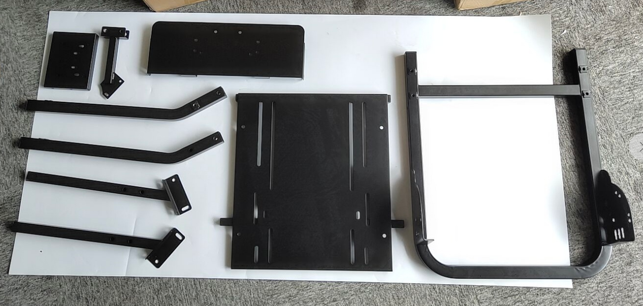
Gear Shift
support
Gear Shift
bracket
table
stand bar
bottom bracket
pedal
telescopic brackets
the whole part drawing

Slide 3
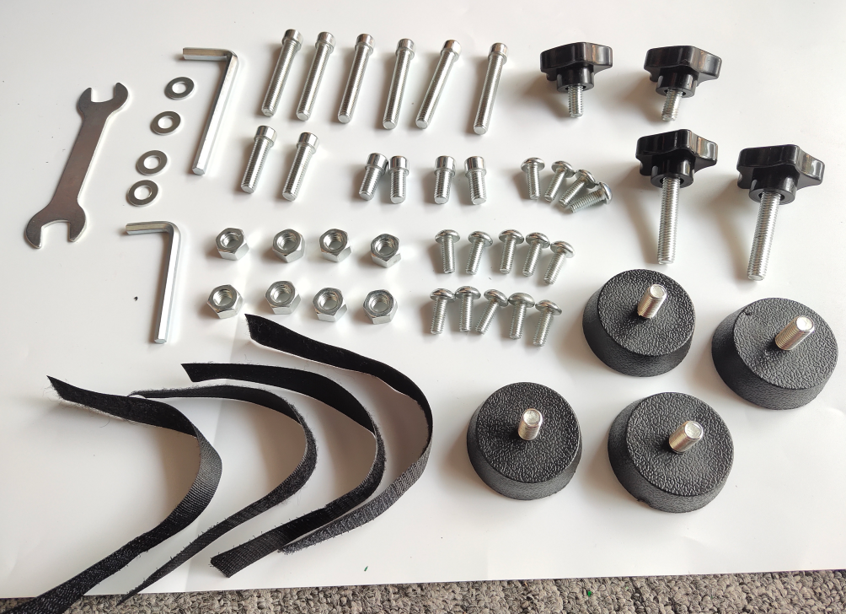
accessory kits
2PC M8×34mm plastic screws
6PC M8×56mm bolts
2PC M8×40mm bolts
wrench
washers
2PC M8×36mm bolts
4PC M8×22mm bolts
14PC M6 bolts of gear shift support
2PC M8×60mm plastic screws
8×8mm nuts
4×cable ties
4PC M8 antiskid foot screws

Slide 4
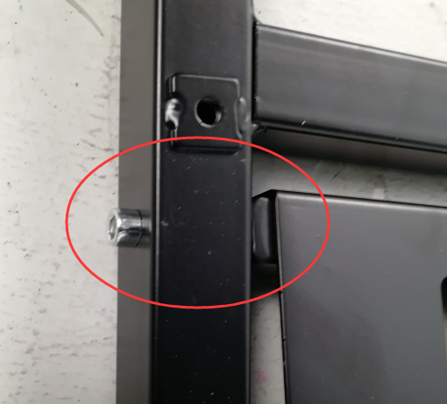
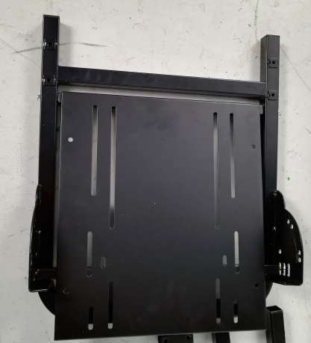
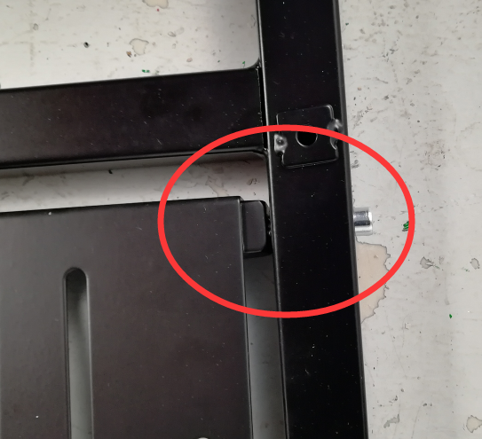
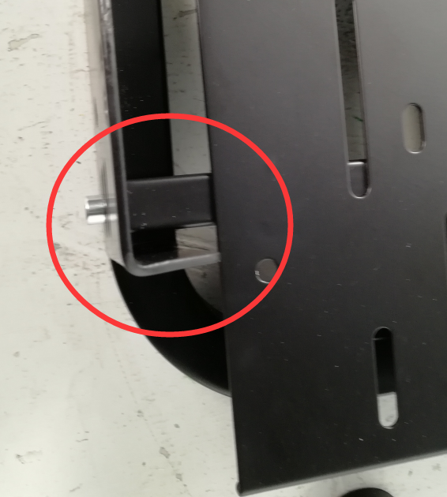
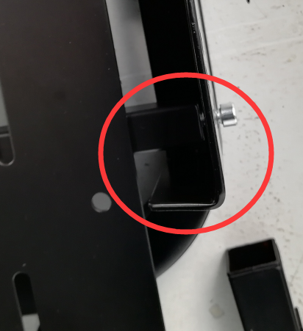
Step 1: We need to lock the bracket base and the pedal with screws. The front part uses M8×56mm bolts and the other part uses M8×36mm bolts.

Slide 5
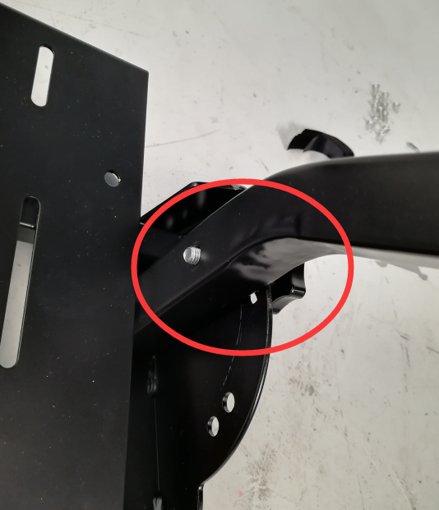
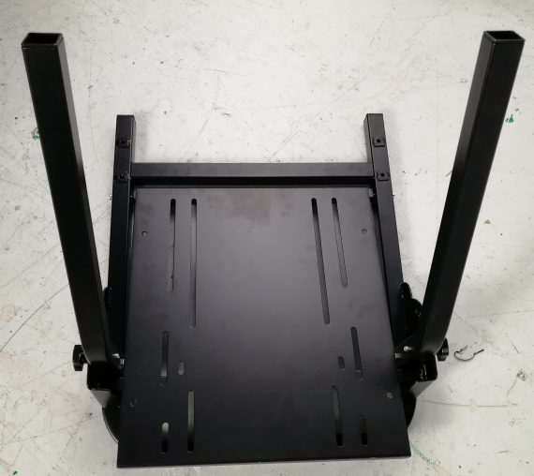
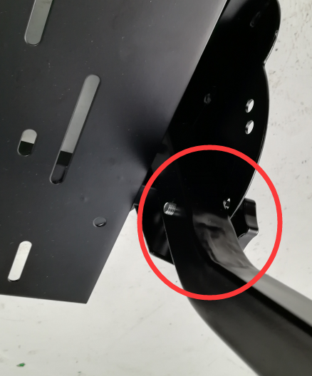
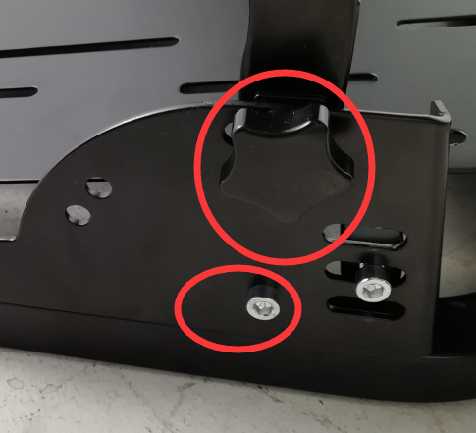
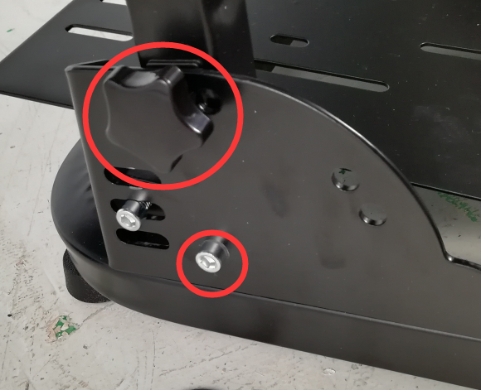
Step 2: First fix the support rod with 2 M8×60mm plastic screws (one left and the other right), then use 2 M8×56mm screws (one on each side) to lock the side with the nuts.
This place is where you screw the bolts in the first step

Slide 6
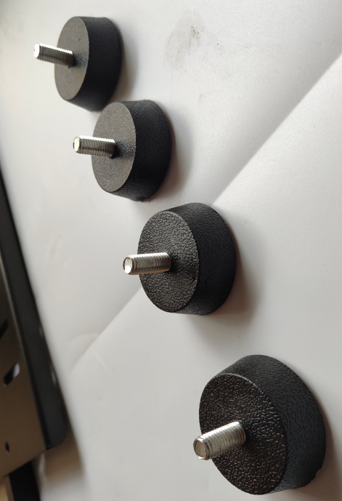
Step 3: Put M8 4 antiskid foot screws on the bottom of the bracket.
The height of the antiskid foot screws can be adjusted.

Slide 7
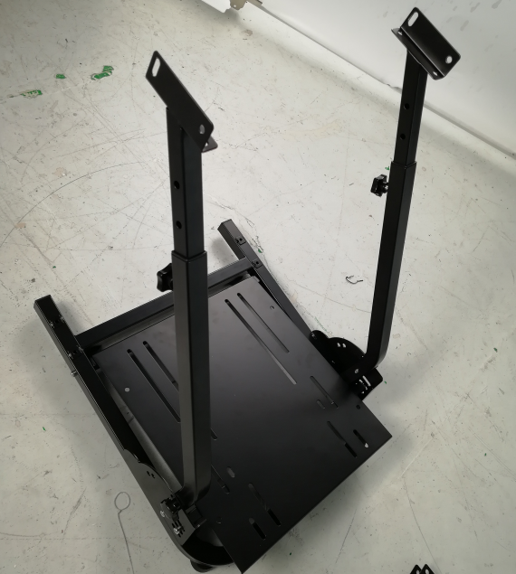
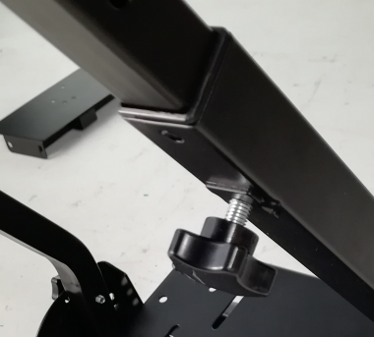
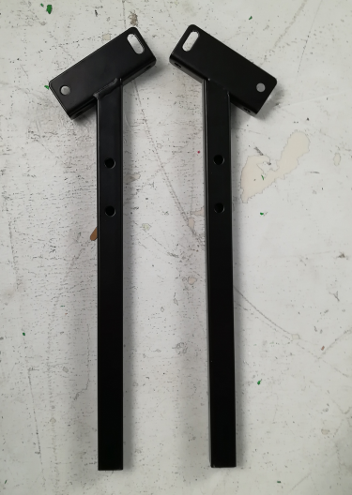
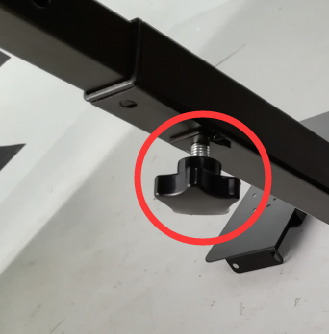
Step 4: Install the telescopic brackets in the inner holes and fix the telescopic brackets with M8×34mm plastic screws (one on each side).
The height of the telescopic brackets can be adjusted according to personal using habits )

Slide 8
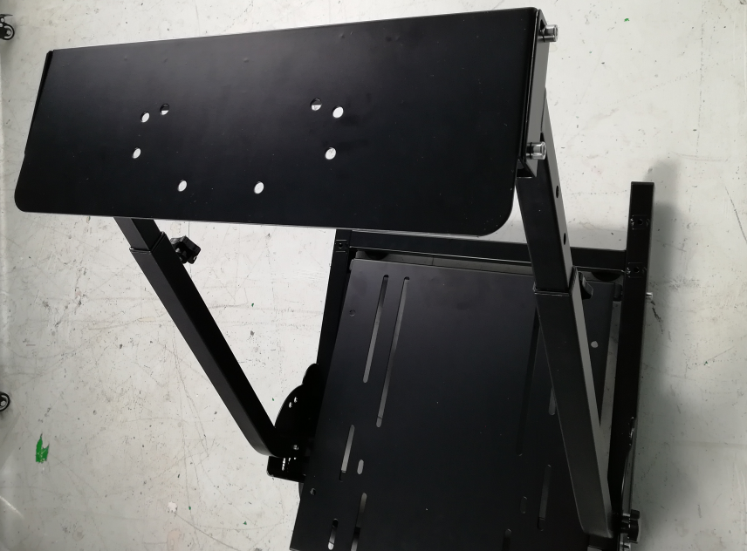
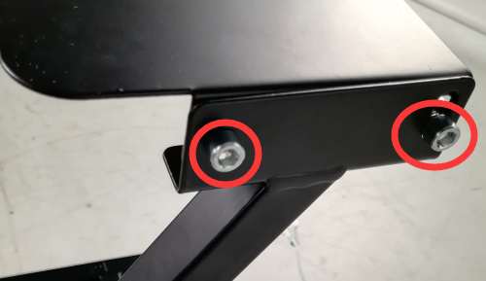
Step 5: Install the table in the holes position of the telescopic brackets, use 4 M8×22mm screws (two screws each on the left and right sides), and lock other side with nuts.

Slide 9
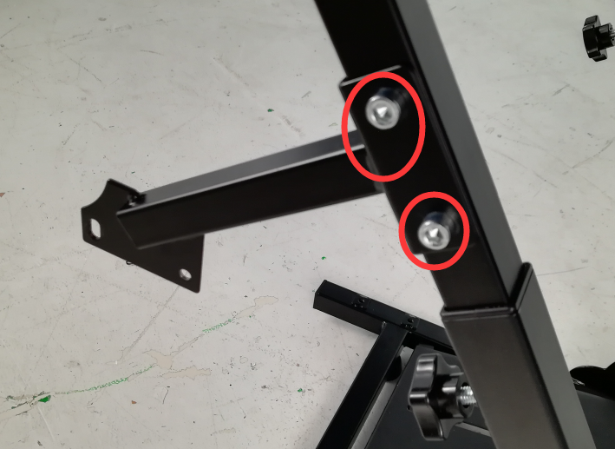
Step 6: Mount the gear Shift bracket with 2 M8×40mm screws on the telescopic bracket, then fix it with the nuts.
(the gear table bracket can be mounted on the left or right side according to the customer's habits)

Slide 10
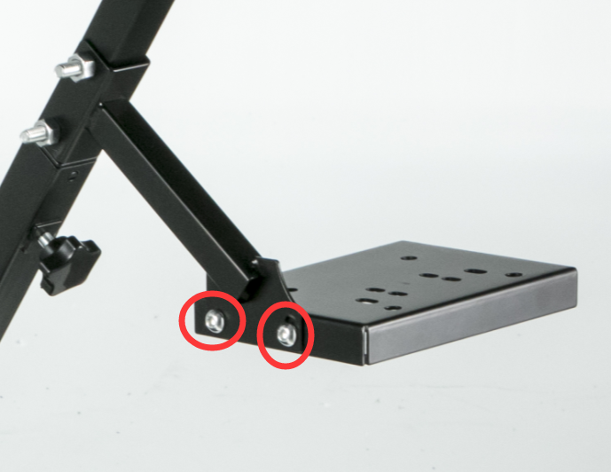
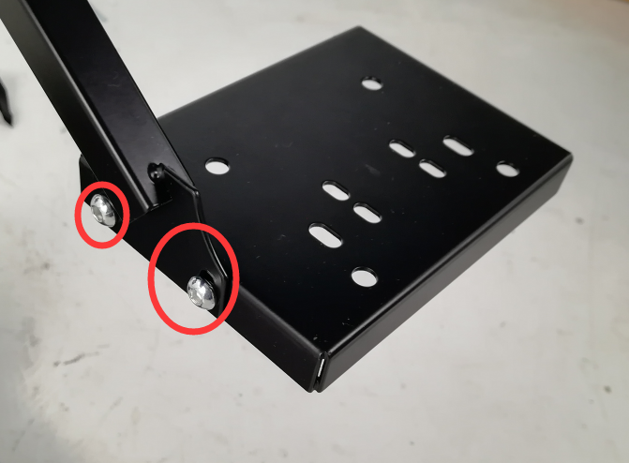
Step 7: Fix the gear Shift support with the M6 bolts on the gear Shift bracket. Then the whole installation step is finished.
Extra screws is for you to install other equipments and the brackets.

Slide 11
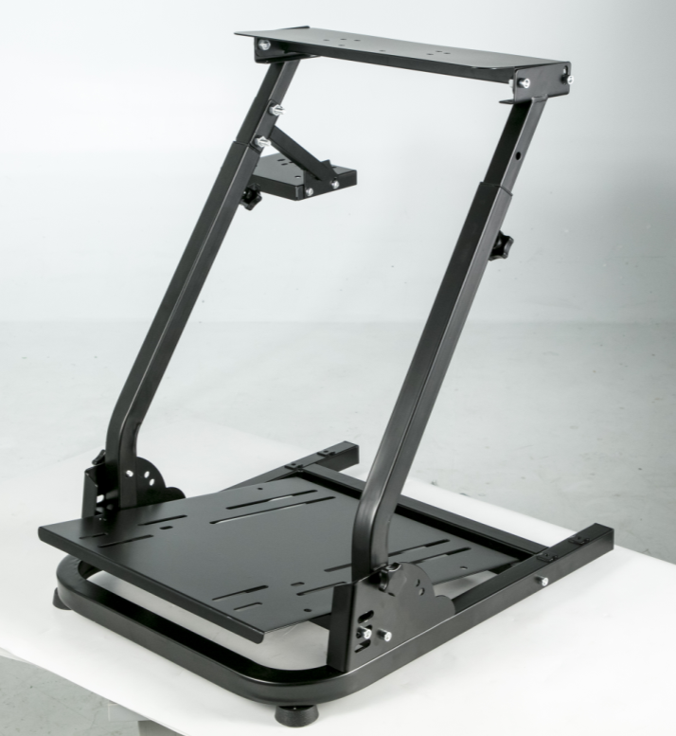
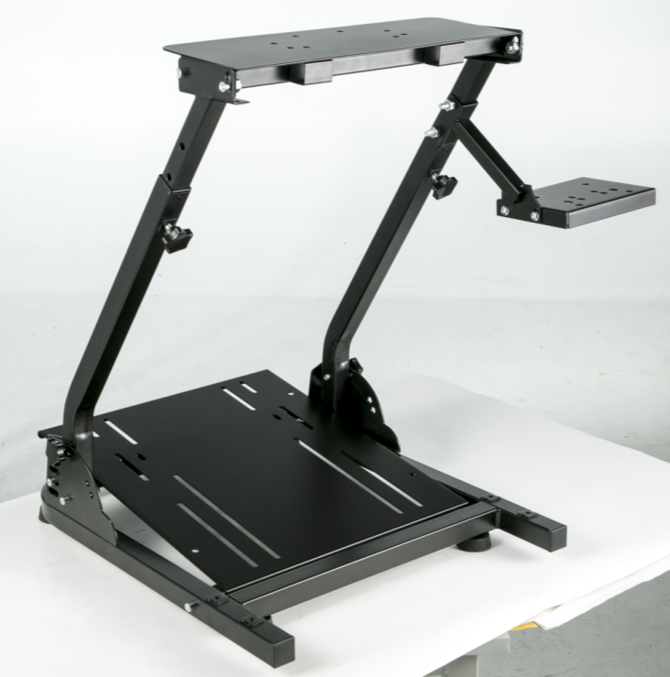
This is the whole finished stand.
If you have any other questions, please contact us.
We specialize in the production of game stands with a variety of styles.
We are glad to provide you products with favorable quality and price.

