Slide 1

Technical Support and E-Warranty Certificate www.vevor.com/support
Laser Engraver
User Manual
We continue to be committed to provide you tools with competitive price.
"Save Half", "Half Price" or any other similar expressions used by us only represents an estimate of savings you might benefit from buying certain tools with us compared to the major top brands and doses not necessarily mean to cover all categories of tools offered by us. You are kindly reminded to verify carefully when you are placing an order with us if you are actually saving half in comparison with the top major brands.
F03-0175-0AA1 Version: A

Slide 2

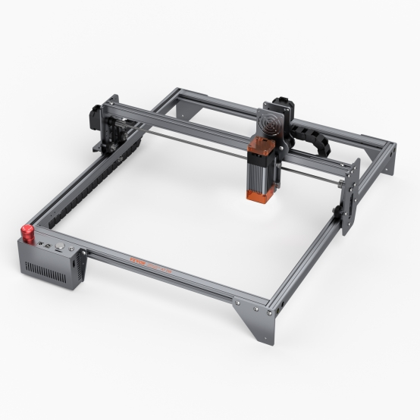
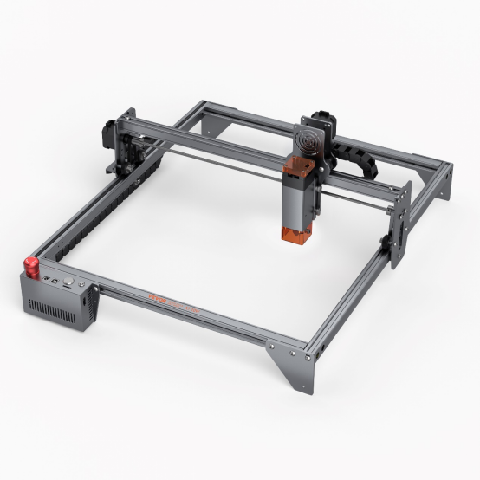
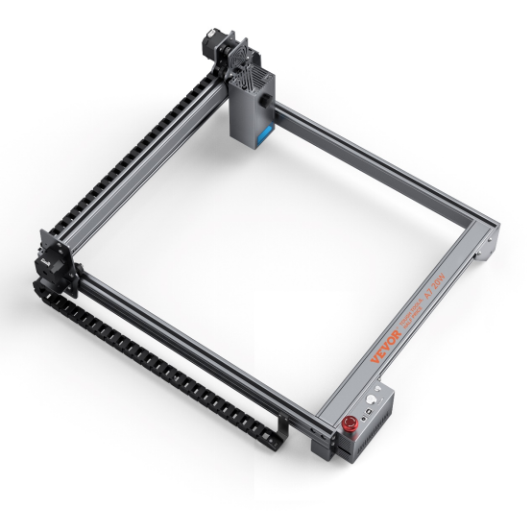
Laser Engraver
A7 5W
A7 10W
G3
20W W
NEED HELP? CONTACT US!
Have product questions? Need technical support? Please feel free to contact us:
CustomerService@vevor.com
This is the original instruction, please read all manual instructions carefully before operating. VEVOR reserves a clear interpretation of our user manual. The appearance of the product shall be subject to the product you received. Please forgive us that we won't inform you again if there are any technology or software updates on our product.

Slide 3







Symbol | Symbol description
 | Warning - To reduce the risk of injury, user must read instructions manual carefully.
 | This symbol, placed before a safety comment, indicates a kind of precaution, warning, or danger. Ignoring this warning may lead to an accident. To reduce the risk of injury, fire, or electrocution, please always follow the recommendation shown below.
 | Danger! Risk of personal injury or environmental damage!Risk of electric shock! Risk of personal injury by electric shock!
 | Warning- Be sure to wear eye protectors when using this product
 | Indoor use only
 | Disposal information: This product is subject to the provision of European Directive 2012/19/EC. The symbol showing a wheelie bin crossed through indicates that the product requires separate refuse collection in the European Union. This applies to the product and all accessories marked with this symbol. Products marked as such may not be discarded with normal domestic waste, but must be taken to a collection point for recycling electrical and electronic devices
 | FCC statement: This device complies with Part 15 of the FCC Rules. Operation is subject to the following two conditions:(1)This device may not cause harmful interference, and (2)this device must accept any interference received, including interference that may cause undesired operation.

Slide 4
Part 1: Security Statment Before Installation
Before using the laser engraving machine, please read this safety guide carefully. It contains information about situations that require special attention, as well as warnings of unsafe practices that can cause damage to your property or even endanger your personal safety.
1. The product belongs to Class 4 laser products, the laser system itself must meet the requirements of IEC 60825-1 latest version, otherwise the product is prohibited from being used.
2. If a protective housing is equipped with an access panel that provides "walk-in" access then:
a)Means shall be provided so that any person inside the protective housing can prevent activation of a laser hazard that is equivalent to Class 3B or Class 4.
b）There is a warning device so as to provide adequate warning of emission of laser radiation equivalent to Class 3R in the wavelength range below 400 nm and above 700 nm, or of laser radiation equivalent to Class 3B or Class 4 to any person who might be within the protective housing.
c) Where “walk-in” access during operation is intended or reasonably foreseeable, emission of laser radiation that is equivalent to Class 3B or Class 4 while someone is present inside the protective housing of a Class 1, Class 2, or Class 3R product shall be prevented by engineering means.
Note:Methods to prevent human from radiation when persons are inside the protective housing can include pressure sensitive floor mats, infrared detectors, etc.

Slide 5
3. The laser itself has a protective cover, the protective cover is fastened by screws or magnets. When the laser is installed on the laser engraver, the protective cover should be checked to be reliably locked, and can not be removed in the energized state.
4. The laser engraver has an emergency stop button, which can immediately stop the output of the laser when pressed under unexpected circumstances.
5. The laser engraver has a reset button, which can resume work under the condition of confirming safety after lifting the interlock or emergency stop.
6. Set a warning mark on any window or channel that can actively observe or passively receive laser radiation on the laser engraving machine.
7. If the laser burns the skin or eyes, please go to a nearby hospital for examination and treatment immediately.

Slide 6
Part 2：User Security Statement
Laser light can cause harm to human eyes and skin. Do not expose your eyes or skin directly to the laser light. This laser product emits a collimated laser beam through an optical lens. The light emitted by the product, whether direct or reflected, can be very harmful as it can travel long distances while maintaining high optical density. When handling the product, it is necessary to wear appropriate goggles (OD5+) to protect the eyes from all laser light, including reflected and stray light. Reflected and stray light that spills into unintended areas should be attenuated and/or absorbed.
2.1 Laser safety
We have installed a laser shield on the laser, which can filter out most of the diffuse reflection of the laser spot. However, when using the laser engraving machine, it is recommended to wear laser protective glasses to prevent eye damage. Avoid skin exposure to type 4 laser beams, especially at close distances. Teenagers must be supervised by their parents while using the machine. Do not touch the laser engraving module while the machine is active.
2.2 Fire safety
Because cutting burns off the substrate, a high-intensity laser beam generates extremely high temperatures and a lot of heat.Certain materials can catch fire during cutting, creating gases and fumes inside the equipment. A small flame usually appears here when a laser beam hits the material. It will move with the laser and will not stay lit when the laser passes by. Do not leave the machine unattended during the engraving process. After use, be sure to clean up the debris, debris and flammable materials in the laser cutting machine. Always keep an available fire extinguisher nearby to ensure safety. When laser engraving machines are used, smoke, vapour, particles, and potentially highly toxic materials (plastics and other combustible materials) are produced from the material. These fumes or air pollutants can be hazardous to health.

Slide 7
2.3 Material safety
Do not engrave materials with unknown properties. Materials Recommended:Wood, bamboo, leather, plastic, fabric, paper, opaque acrylic, glass. Materials not recommended:Metal, precious stones, transparent materials, reflective materials etc.
2.4 Use Safety
Use the engraver only in horizontal position and ensure that it has been securely fixed to prevent fires caused by accidental shifting or dropping from the workbench during work. It is forbidden to point the laser at people, animals or any combustible object, whether it is in working condition or not.
2.5 Power safety
To prevent accidental disasters such as fire and electric shock, the laser engraver provides a power adapter with a ground wire. When using the laser engraving machine, insert the power plug into a power socket with a ground wire with a ground wire when using the Laser Engraver.
2.6 Environment safety
When installing engraving and cutting equipment, please make sure that the workplace must be cleaned up, and that there should be no flammable and explosive materials around the equipment. A metal plate must be placed under the bottom when engraving or cutting.

Slide 8
Part 3: Disclaimer and warning
This product is not a toy and is not suitable for people under 15. Do not allow children to touch the laser module. Please be careful when operating in scenes with children.
This product is a laser module. Please read the operating instruction manual carefully. VEVOR reserves the right to update this disclaimer and safe operation guide.
Please be sure to read this document carefully before using the product to understand your legal rights, responsibilities and safety instructions. Otherwise, it ma-y bring property loss, safety accidents, and hidden danger to personal safety. Once you use this product, you shall be deemed to have understood, and accepted all terms and contents of this document. User undertakes to be responsible for his or her actions and all consequences arising therefrom. User agrees to use the Product only for legitimate purposes and agrees to the entire terms and contents of this document and any relevant policies or guidelines that VEVOR may establish.
You understand and agree that VEVOR may not be able to provide you with the cause of the damage or accident and provide you with after-sale service unless you provide the original engraving or cutting files, engraving software configuration parameters used, operating system information, video of the engraving or cutting process, and operational steps prior to the occurrence of a problem or failure.
VEVOR is not liable for any and all losses arising from the user's failure to use the product in accordance with this manual,Without the guidance of the company's technical personnel, users are prohibited from disassembling the machine by themselves. If this behavior occurs, the loss caused by the user shall be borne by the user.
VEVOR has the ultimate right to interpret the document, subject to legal compliance. VEVOR reserves the right to update, modify, or terminate the Terms without prior notice.

Slide 9
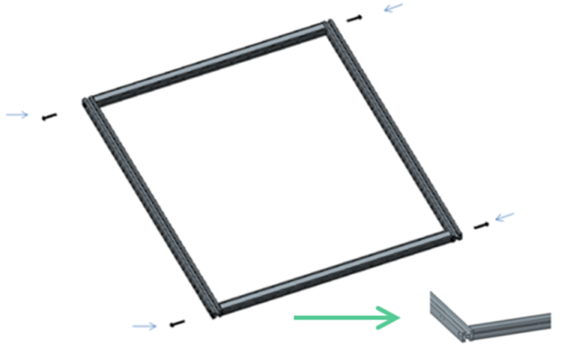
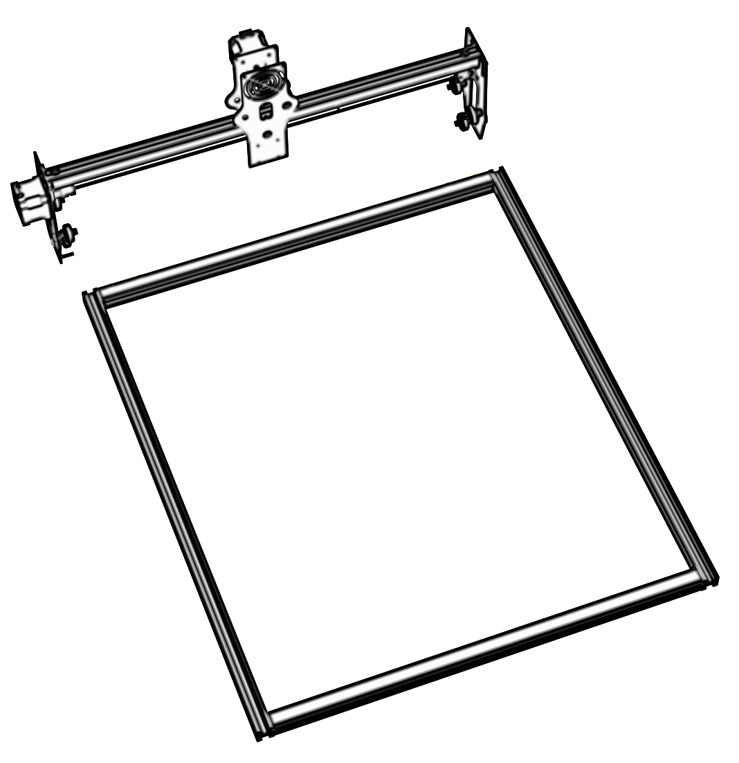
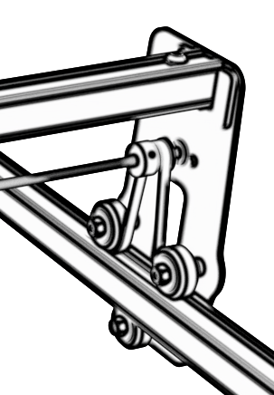
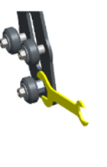
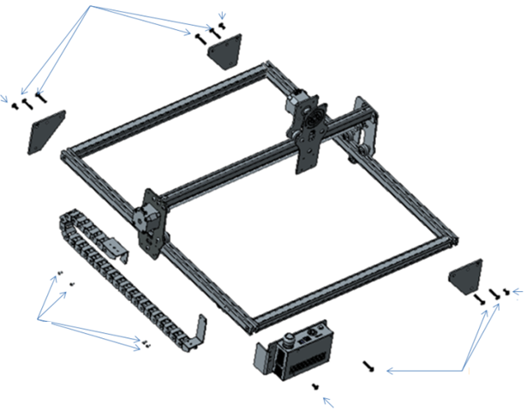

Part 4：Installation Steps
Step1：Assemble the frame
M5X25
M5X25
M5X25
M5X25
Step2：Install the X-axis assembly
If installation is difficult, adjust the offset wheel
The guide rail passes through the middle of the 3 rollers. Loosen the distance between the upper and lower guide wheels appropriately.
Step3：Install the support foot assembly and the Y-axis tank chain
M5X15
M5X8
After assembly, if you find that the four feet are not aligned, please slightly loosen the screws of the support feet. After the four feet are aligned, tighten the screws again.
M5X8
M3X6
M5X8
M5X8
M5X15

Slide 10
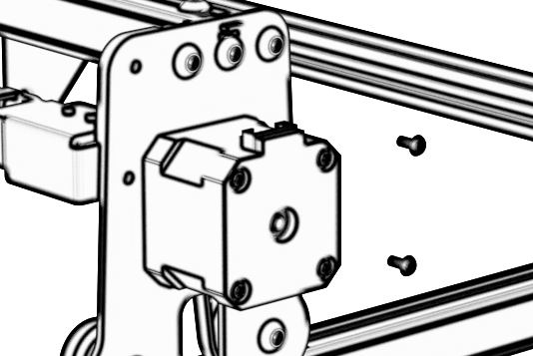
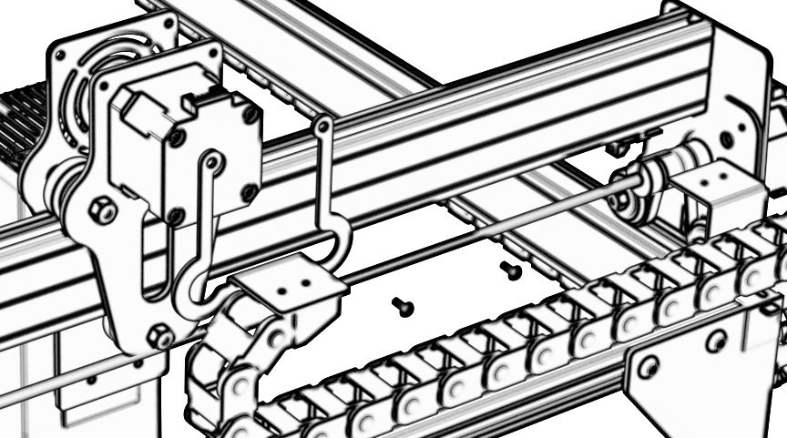
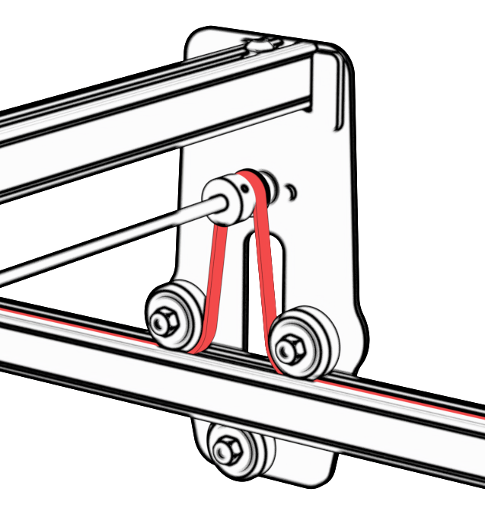
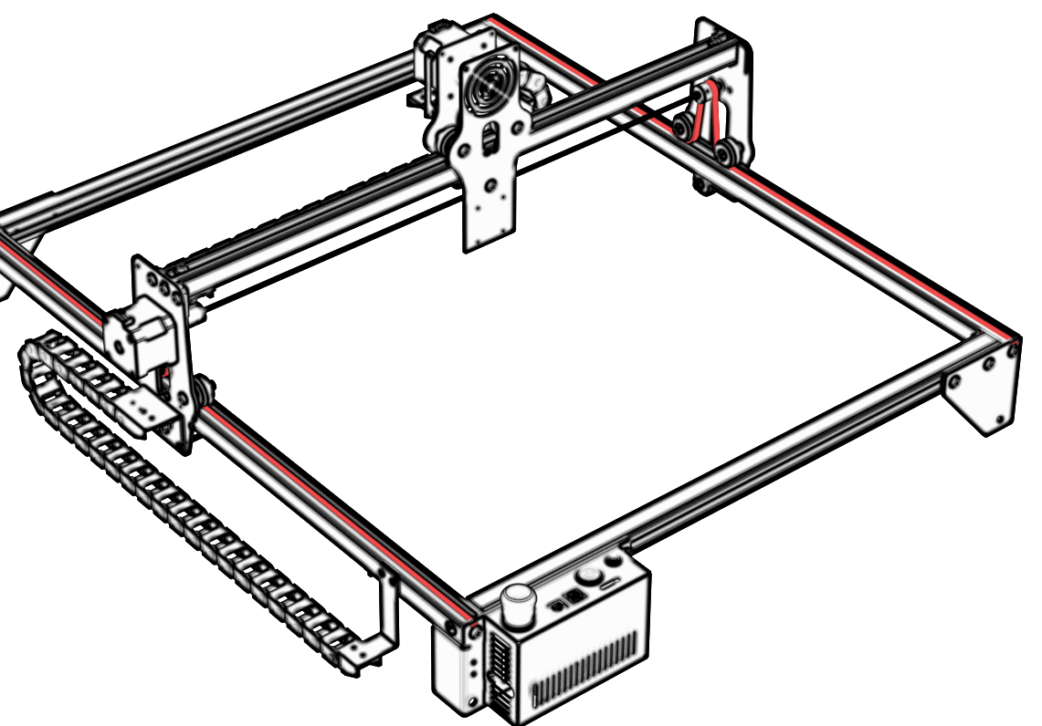
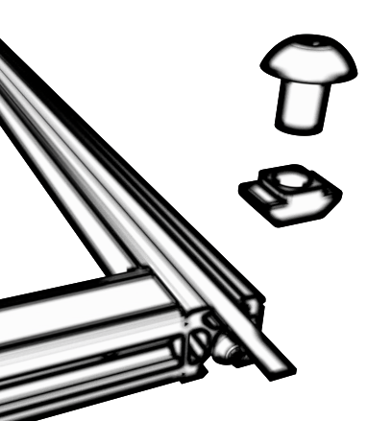
Step4：Install the X-axis tank chain
M3X6
M3X6
M3X6
Step5：Install the timing belt
Using M5 × 6 T-shaped combination nut locking with belt

Slide 11
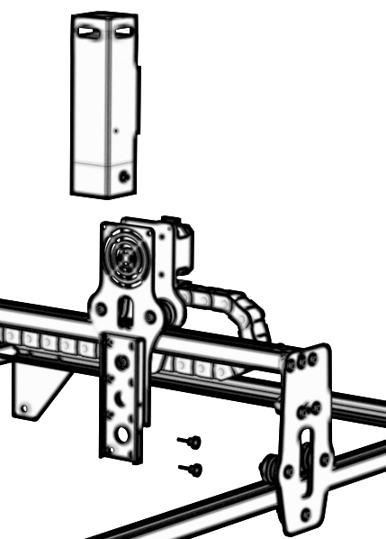
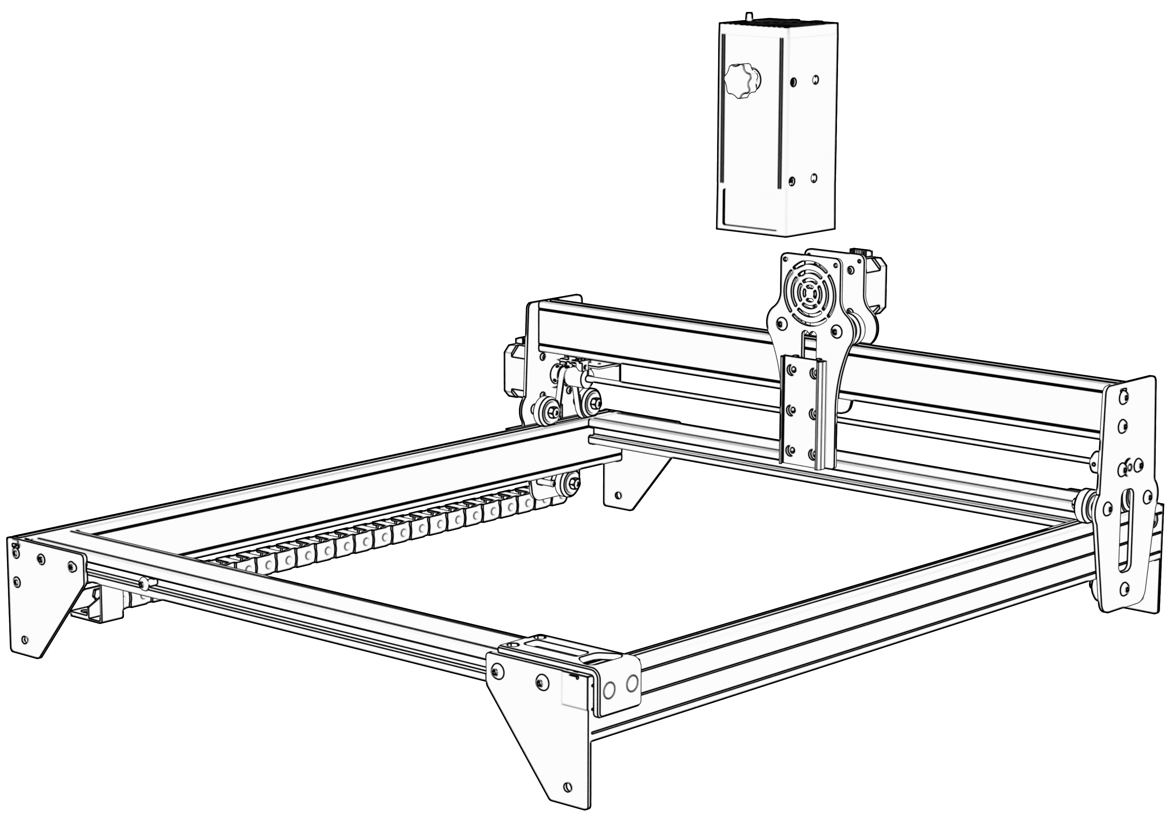
Step6.1：Step6：Laser installation (for 5W and 10W models)
M4X12
Step6.2：Mounting laser (for 20W)）

Slide 12
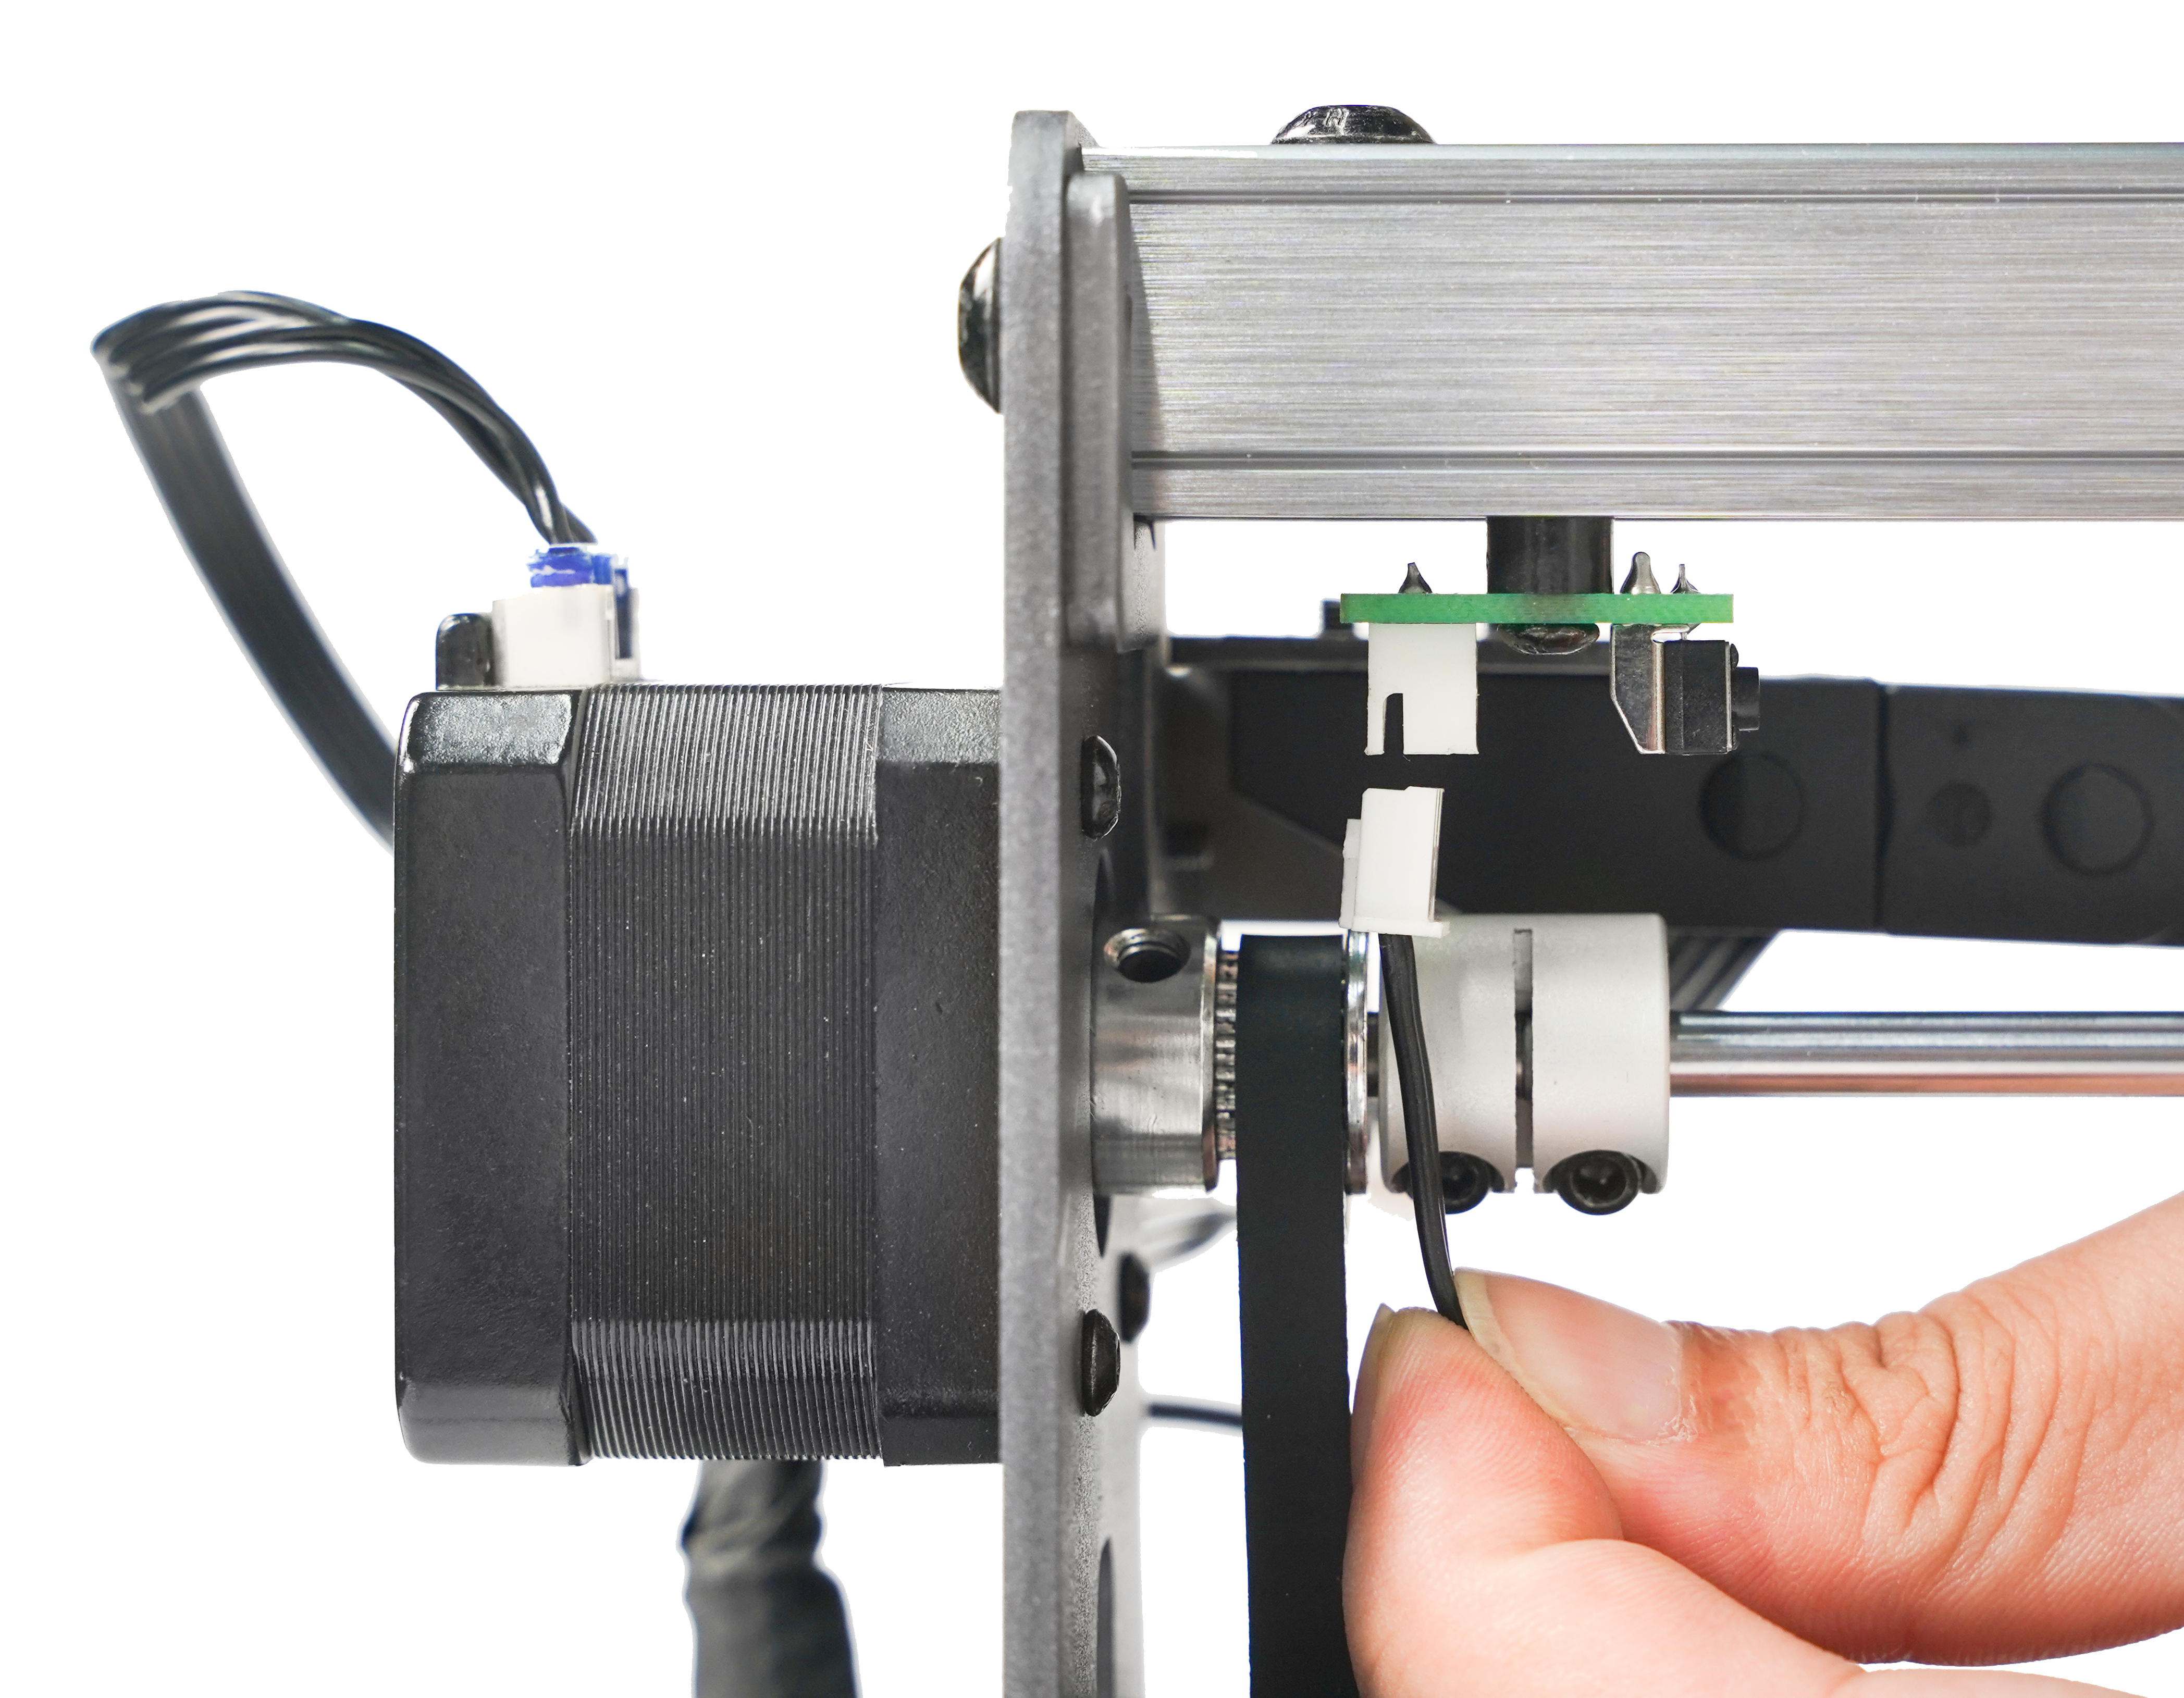
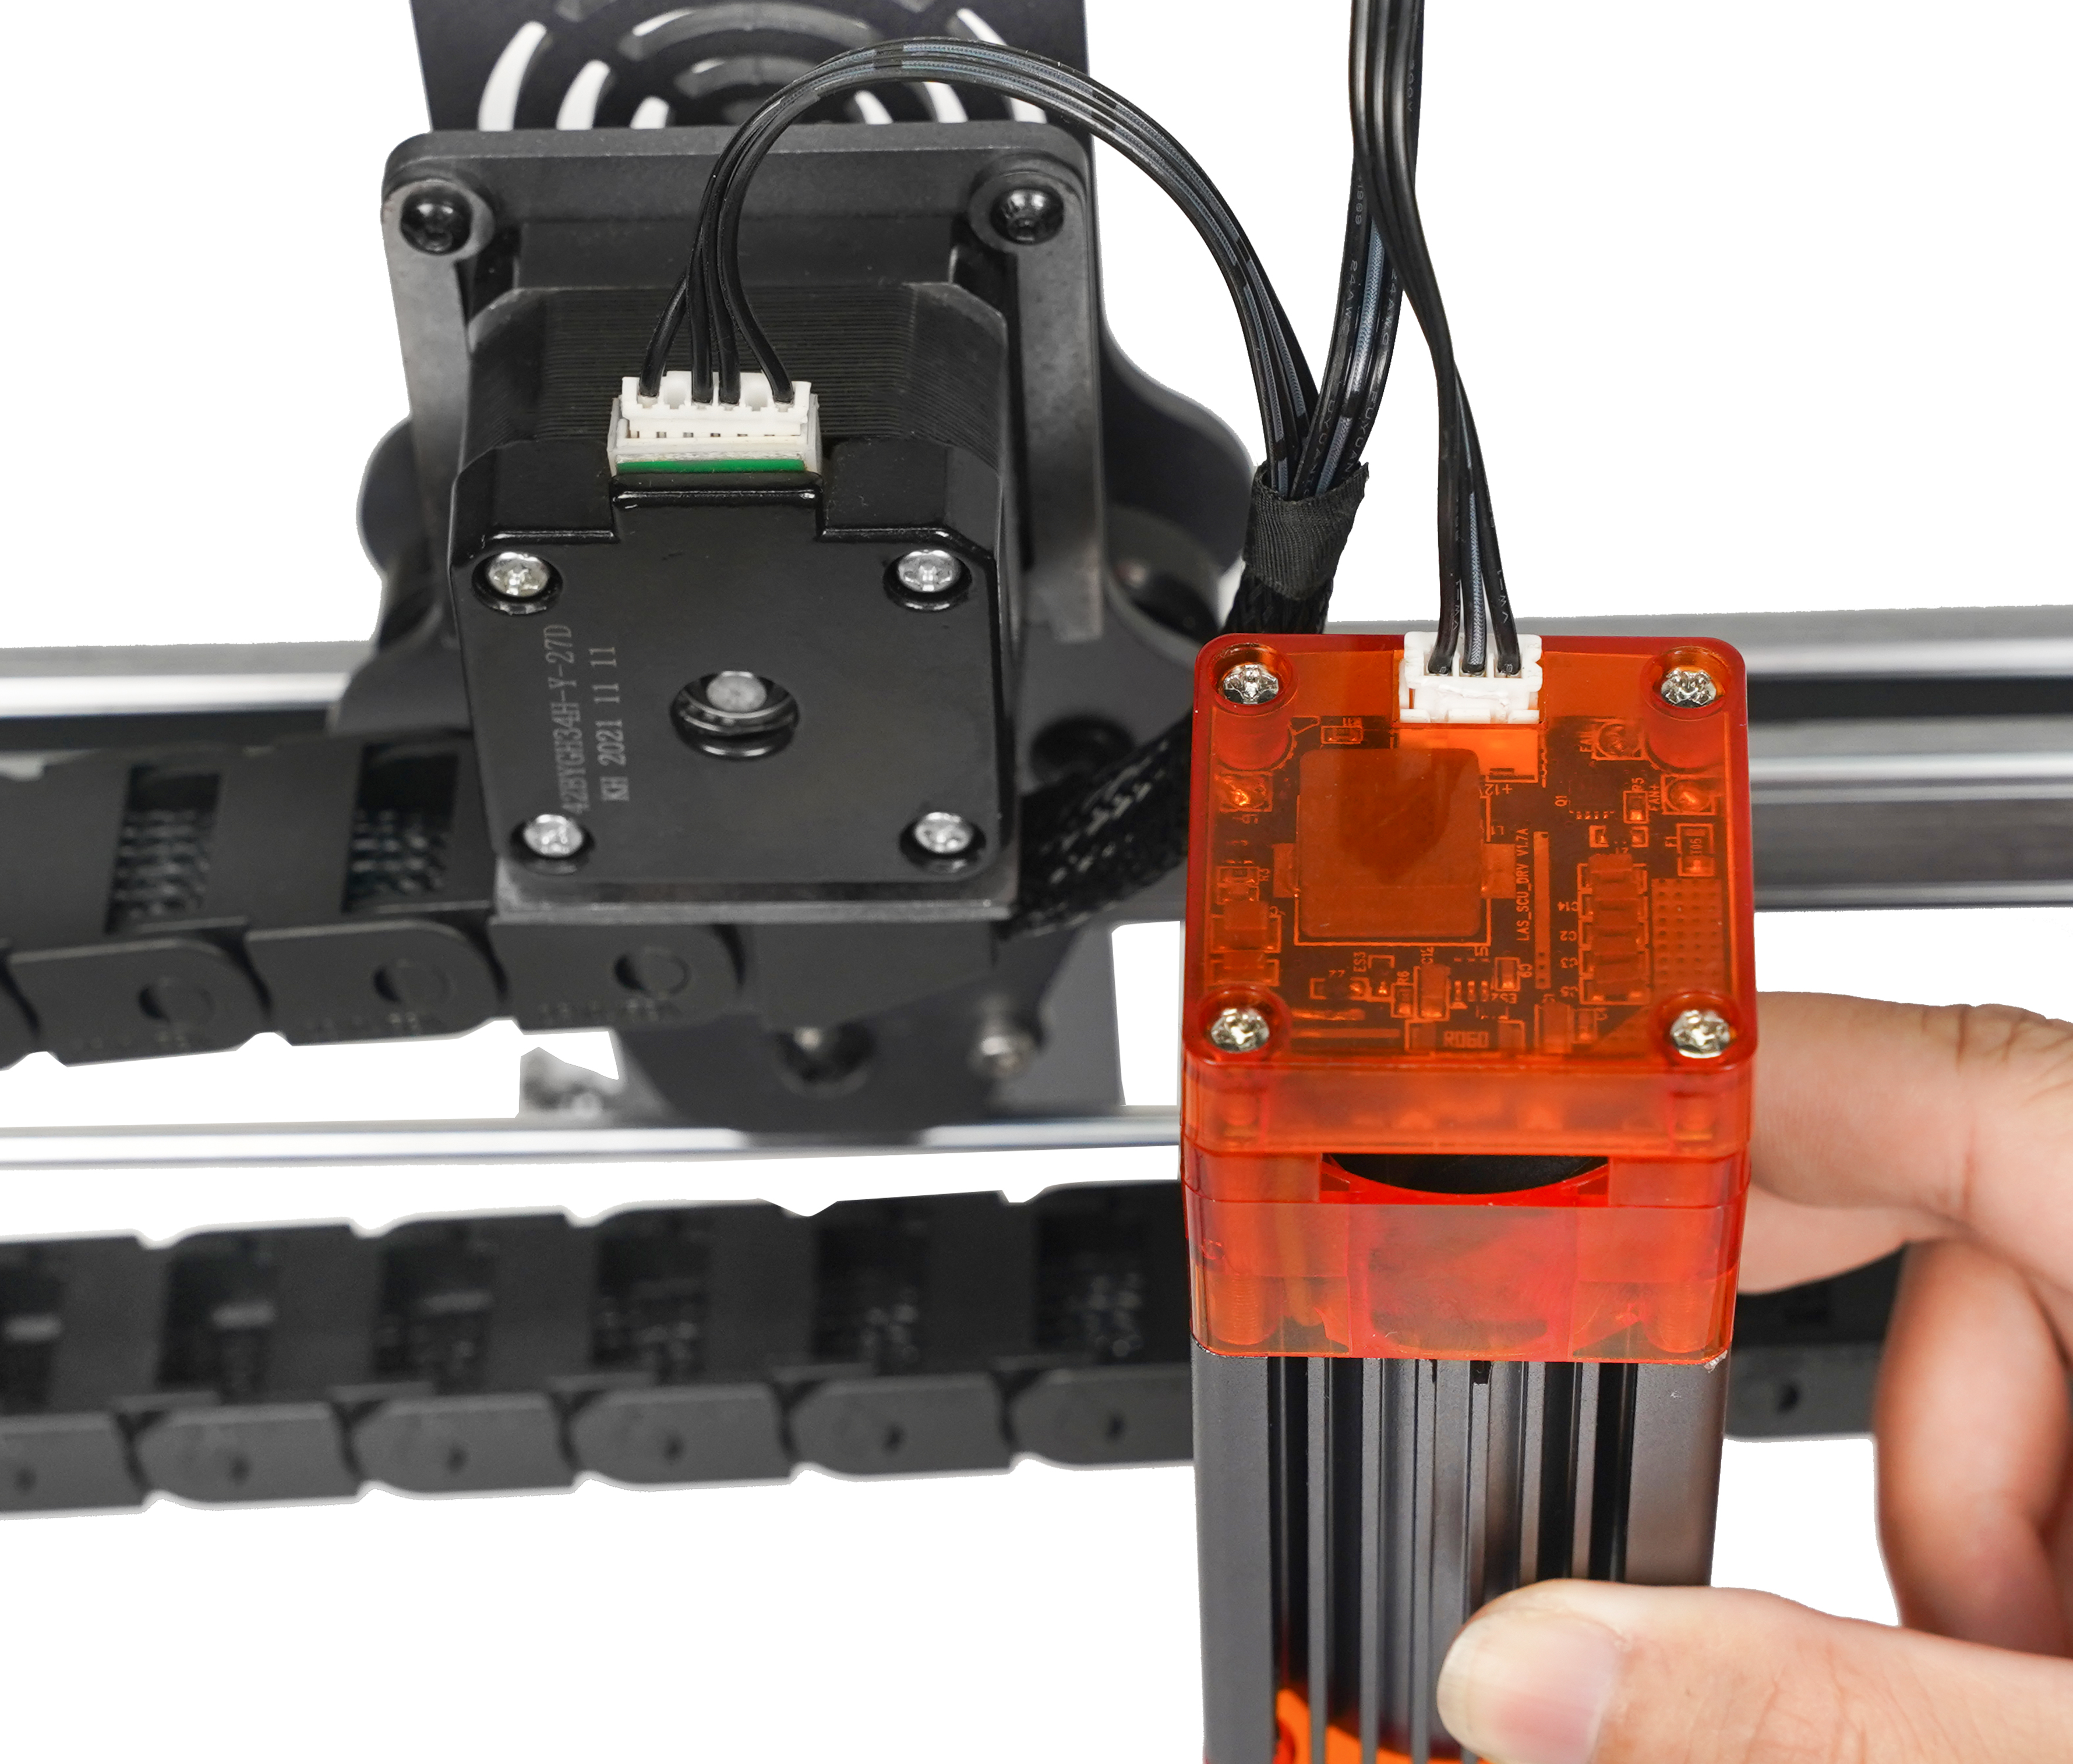
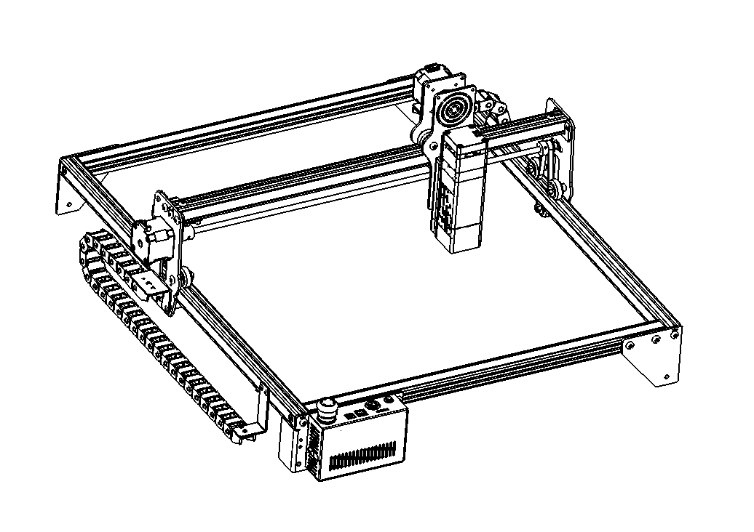
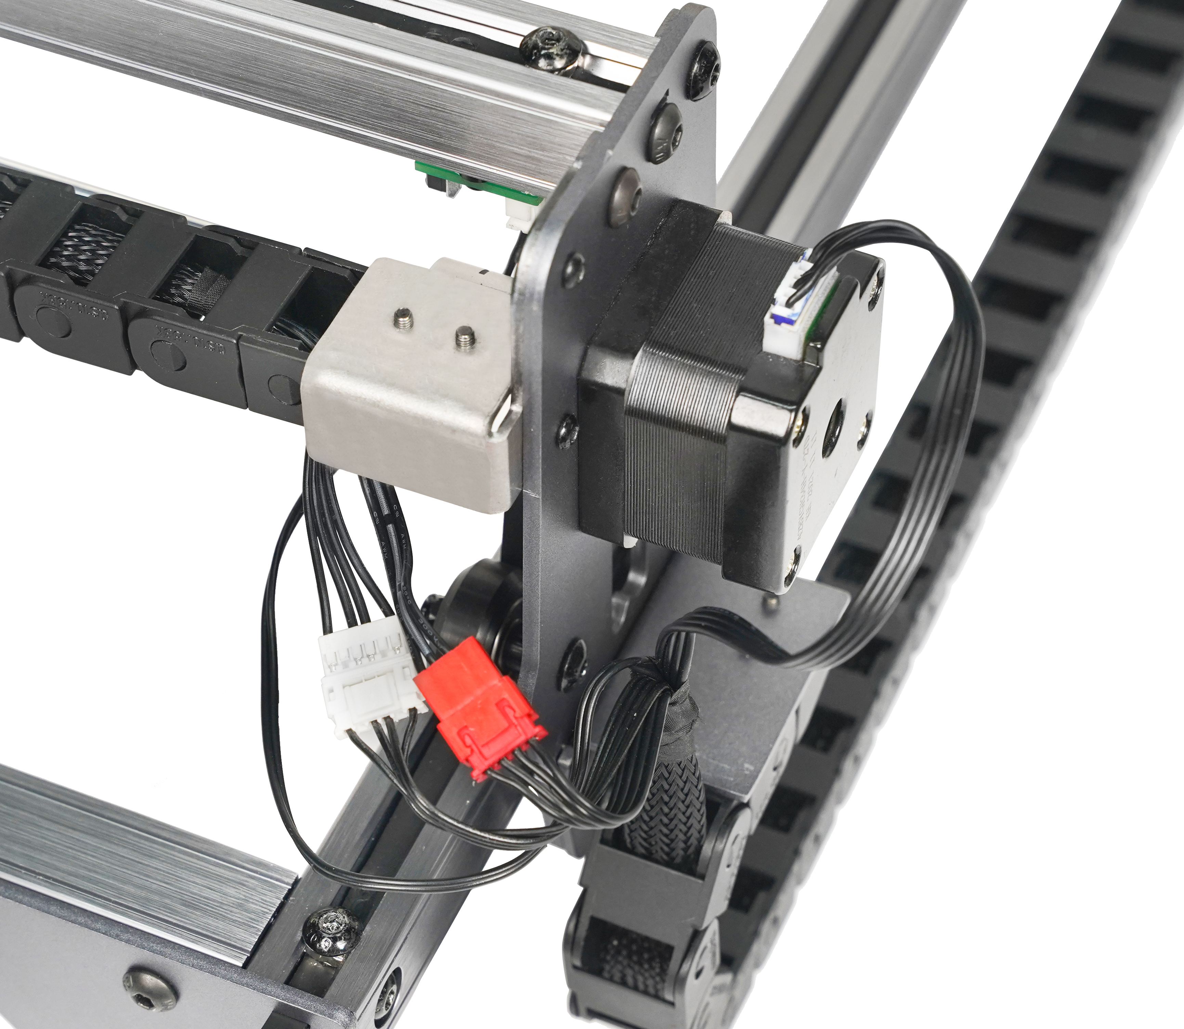
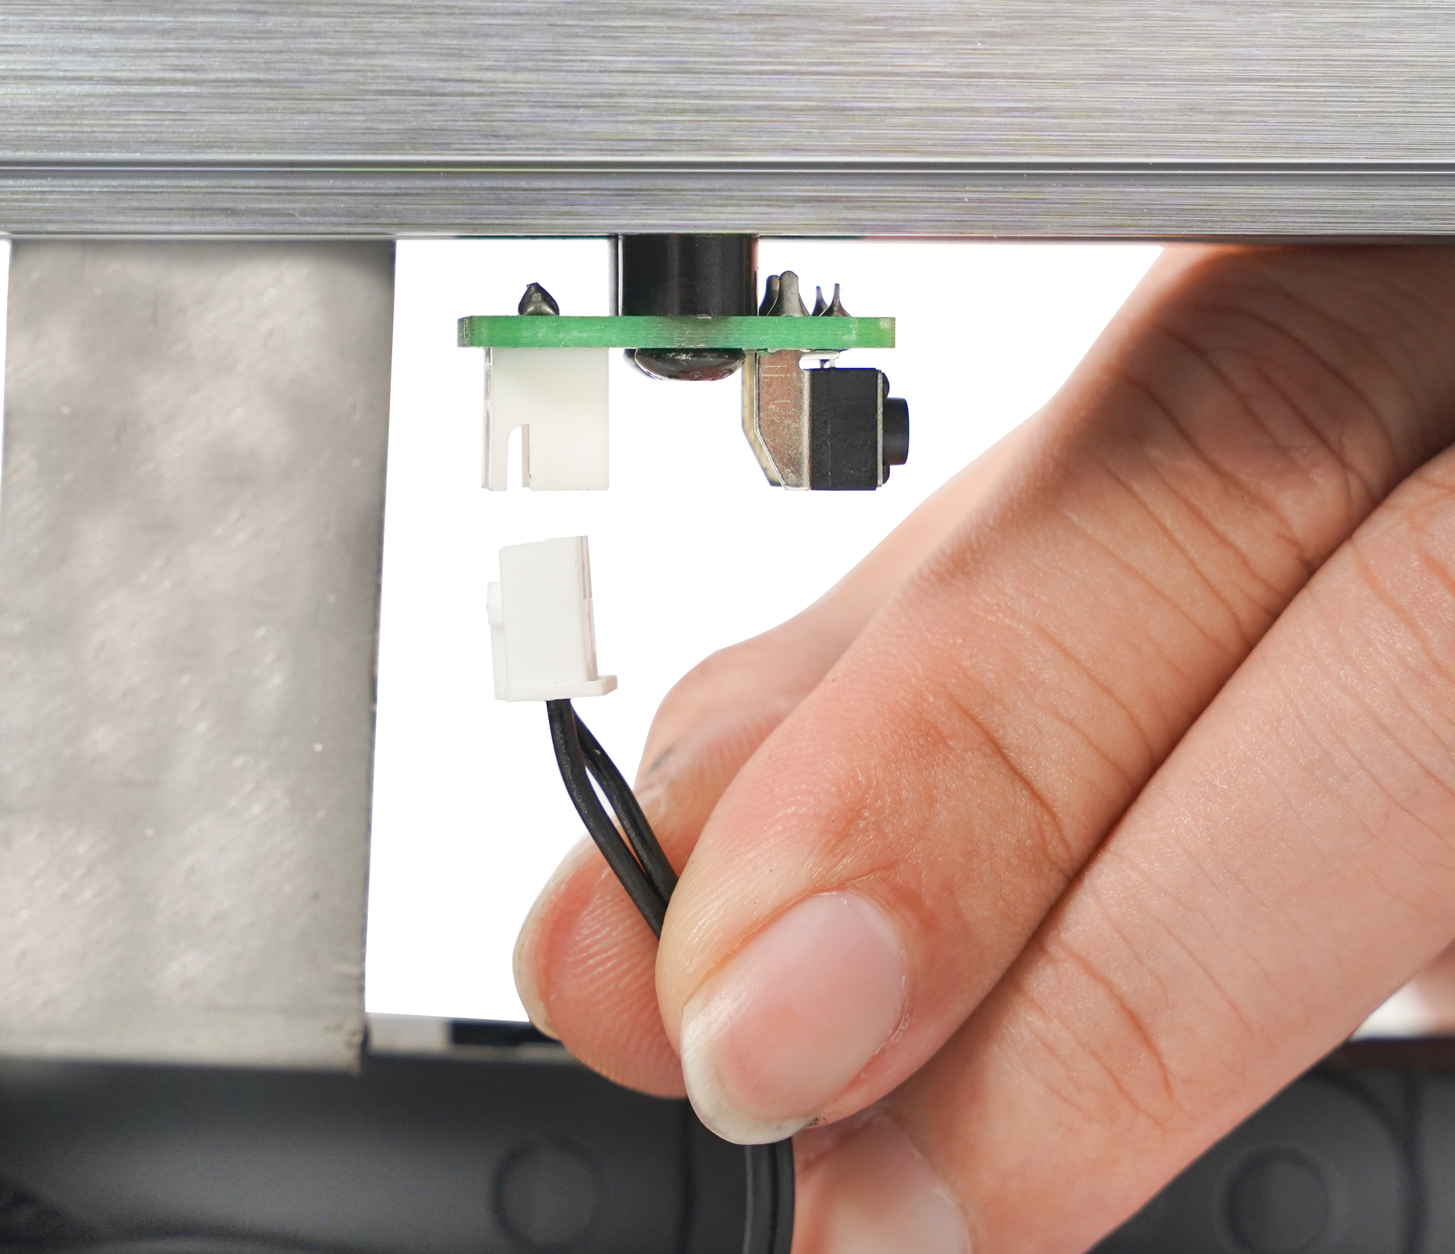
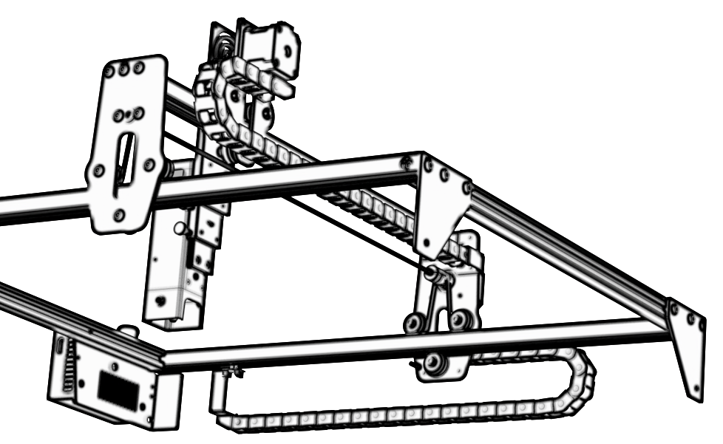

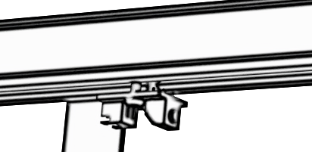
Step7：Install the cable
4
5
3
2
blue terminal
1
Step8：Adjust the eccentric wheel
Use a wrench to turn the eccentric nut to adjust the tightness of the guide wheel and the guide rail
TIPS：How to determine the tightness of eccentric nuts?
Under the condition of ensuring that the bracket does not shake, you can lift one end of the machine to an angle of 45 degrees with the horizontal plane, and release the X-axis or Y-axis bracket from a high place. If the bracket can slide at a constant speed to the end, the tightness is suitable.

Slide 13
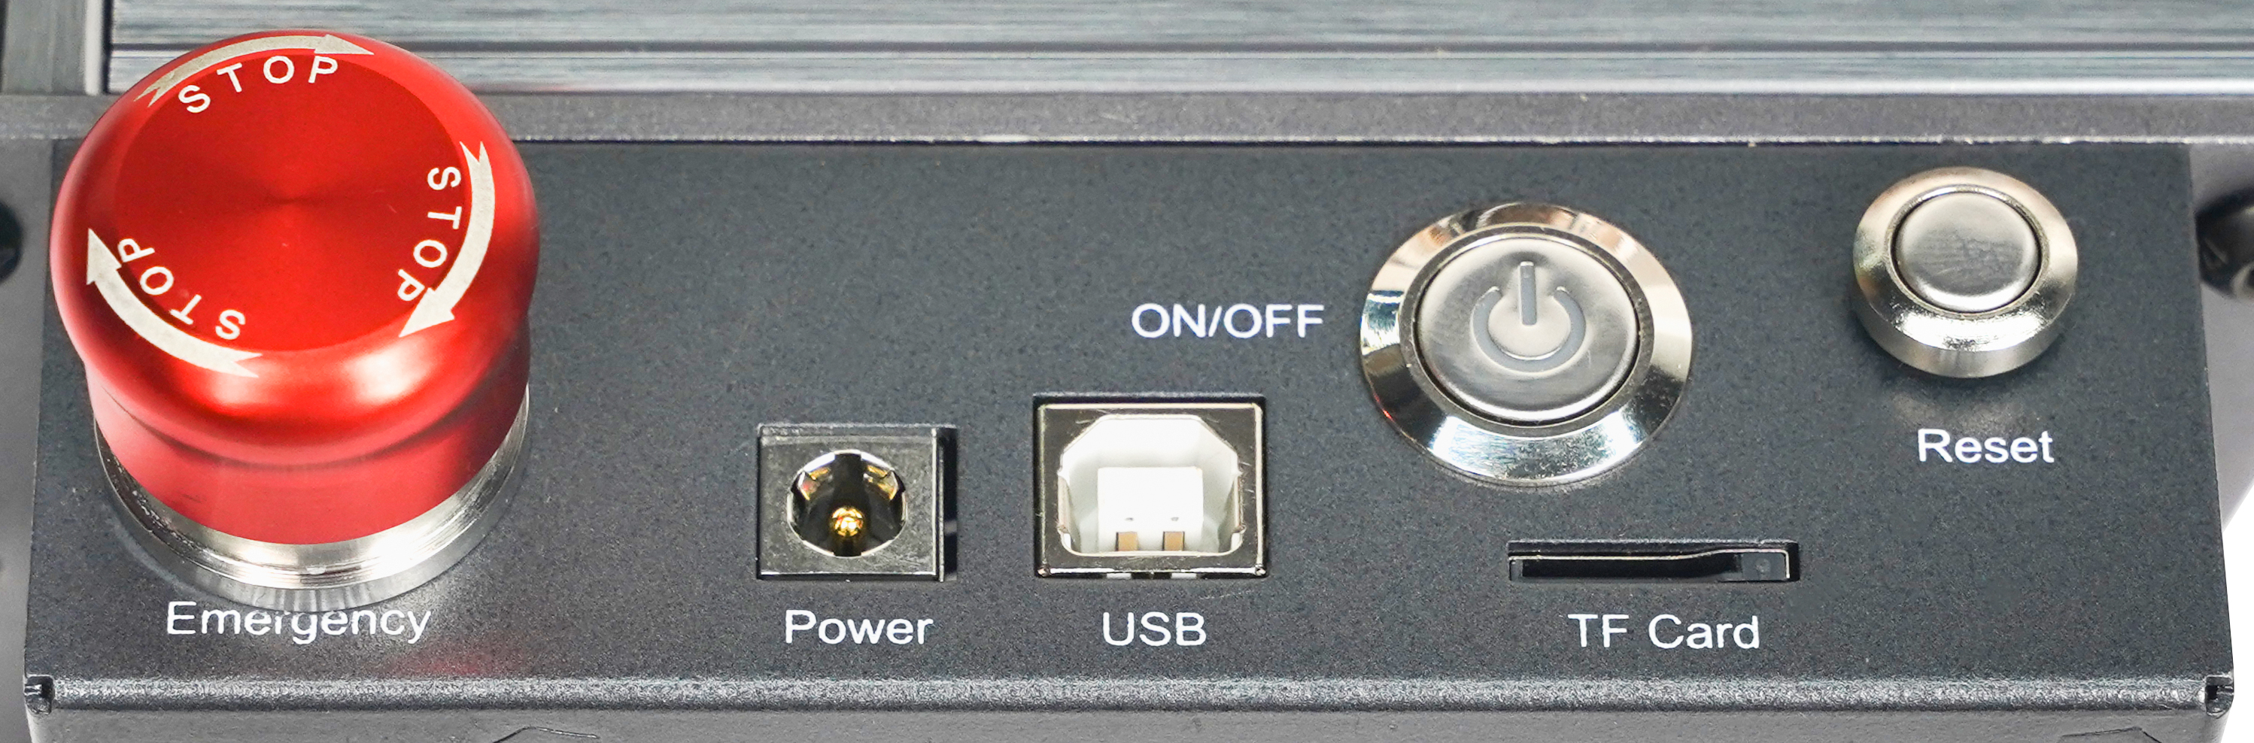
Part 5：Control box description
4
6
3
2
5
1
1.Emergency stop switch：In case of emergencies, the machine will immediately stop working when you press it. When you need to unlock it, turn the button clockwise to restart the engraver.
2.Power socket: DC 12V power supply(A7),DC 24V power supply(G3).
3.USB interface: control the engraver on the computer by connecting to the computer through a USB cable.
4. Power switch: control the power on and off.
5. TF card slot: here to insert the TF card(TF card needs to be purchased by yourself).
6. Reset switch: When an emergency occurs or the machine is stuck, press the reset button to restart the engraver.
Before use, please make sure that the emergency stop switch is in the up state.

Slide 14
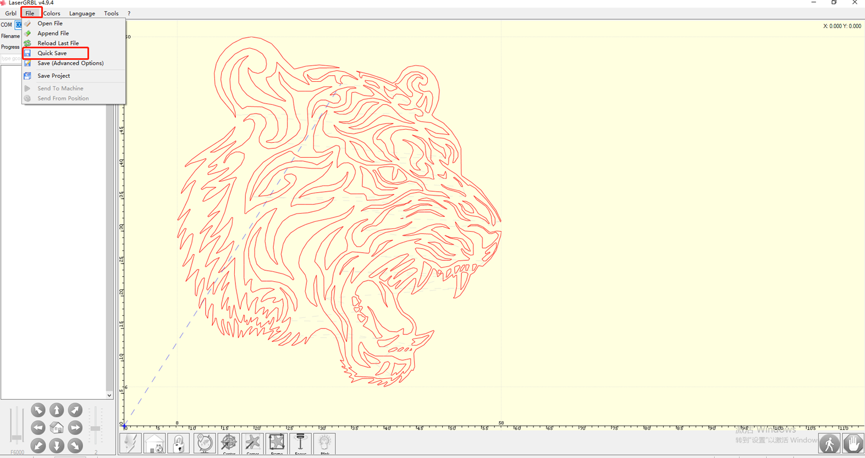
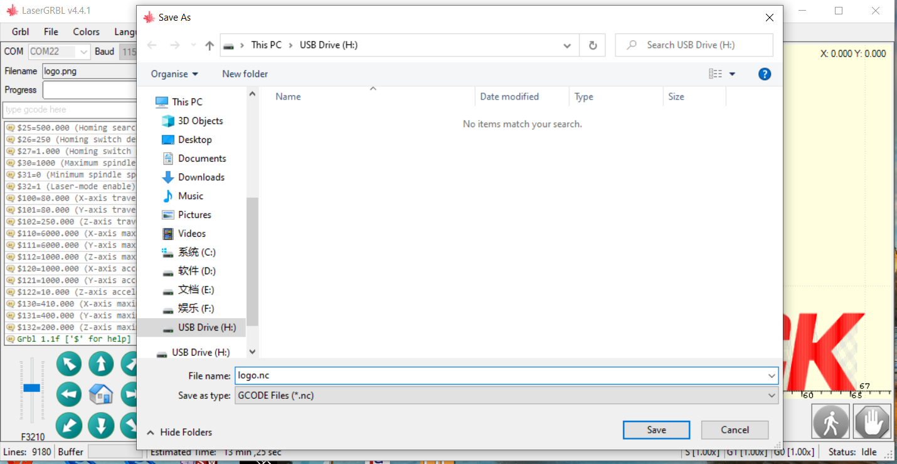
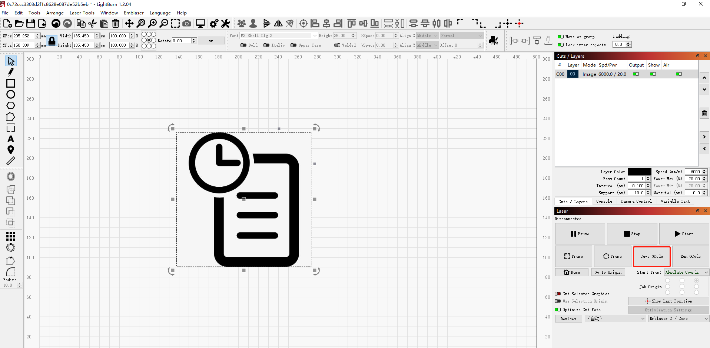
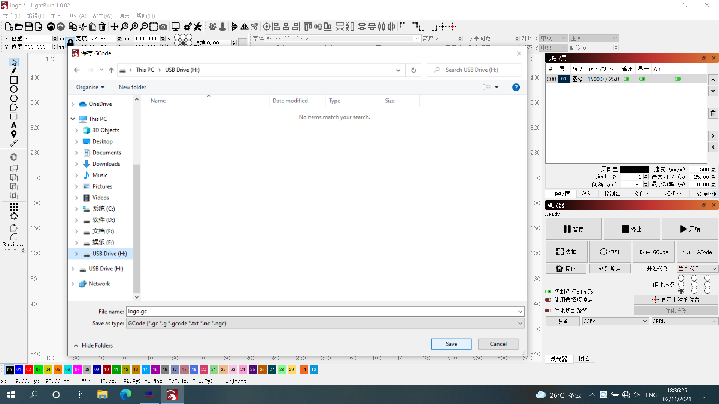
Instructions for exporting nc and gc format files
1.LaserGRBL software
1.Import the picture to be engraved or cut into laserGRBL. After setting the engraving speed and energy parameters etc., click File, and select Quick Save
2.Select TF card as the save path, click Save to generate nc file.
2.Lightburn software
1.Import the picture to be engraved or cut into Lightburn. After setting the engraving speed and energy parameters etc., click Save Gcode.
2.Select TF card as the save path, click Save to generate gc file.

Slide 15
Part 6：Software installation and use
1. Downloading LaserGRBL software
2. Installing LaserGRBL
3. Adding custom buttons
4. Connect laser engraving machine
5. Setting Engraving Parameters
6. Laser focus adjustment
7. Positioning
8. Start, Termination carving or cutting
9. LightBurn Installation Tutorial

Slide 16
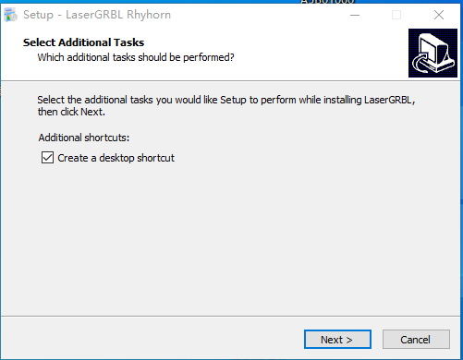


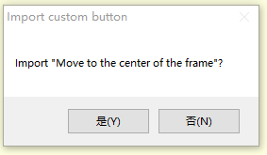
1. Downloading LaserGRBL software
LaserGRBL is one of the most popular DIY laser engraving software in the world, LaserGRBL download website:
http://lasergrbl.com/download/
2. Installing LaserGRBL
Double-click the software installation package to start the software installation, and keep clicking Next until the installation is complete.(Picture1)
Picture1: LaserGRBL software installation
3. Adding custom buttons：
1.The software supports users to add custom buttons, you can add custom buttons in the software according to your usage. We recommend the official Custom Buttons from LaserGRBL. Custom button download address: http://lasergrbl.com/usage/custom-buttons/. The downloaded custom button is displayed as shown in the figure. (Picture2)
Picture 2:custom button package
2.Next, we will load the custom buttons into the LaserGRBL software. In the LaserGRBL software, right-click on the blank space next to the bottom button (as shown in Picture 3) -> Import custom button, then select the custom button zip file downloaded to import, keep pressing Yes (Y) until no window pops up. (Picture 4、Picture 5）
Picture 3: adding custom button
Picture 4: custom button loading

Slide 17
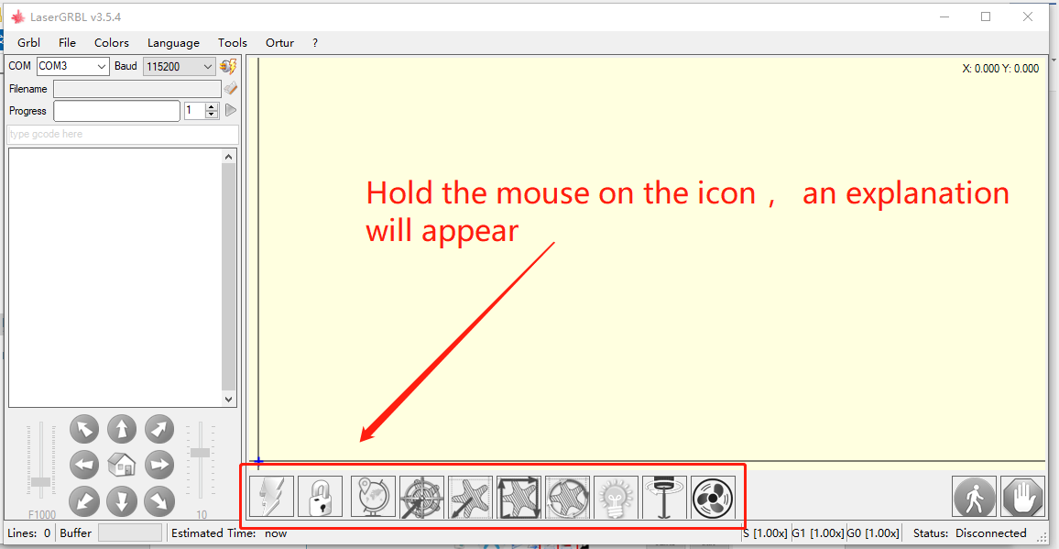
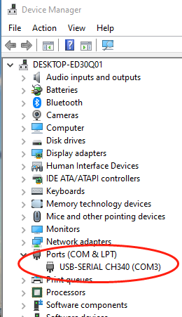
The installed software is shown as the following figure.
Picture 5: Software button
4. Connect laser engraving machine
A.Connect the engraver to a computer with LaserGBRL software installed.
B. Plug in the power supply of the engraving machine.
C. Open the LaserGRBL software
D.Select the correct port number and baud rate in the software - 115200, (in general, COM ports do not need to be selected manually, but if you have more than one serial device connected to the computer, it needs to do so, you can find the port of the laser engraver in the device manager of the Windows system, Or you can simply try the port numbers displayed one by one).
Check the port number

Slide 18
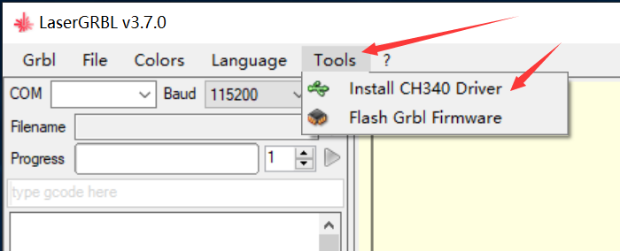
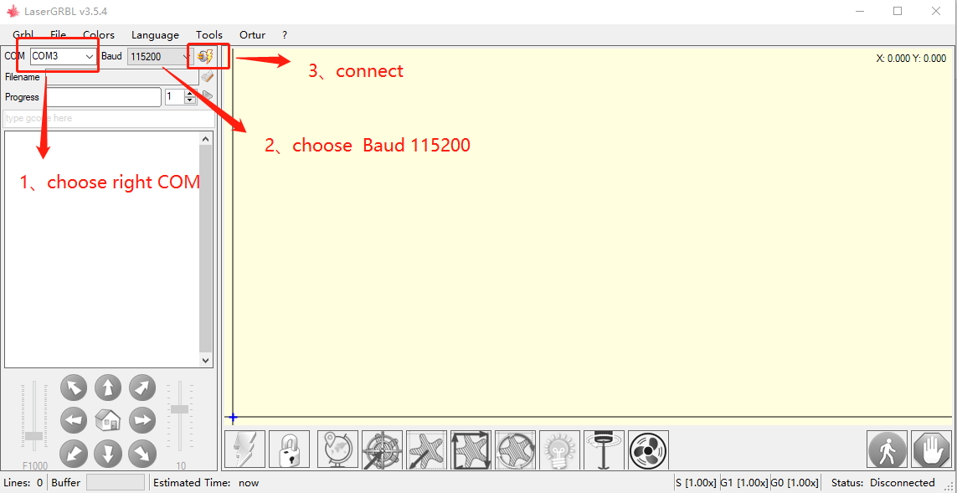
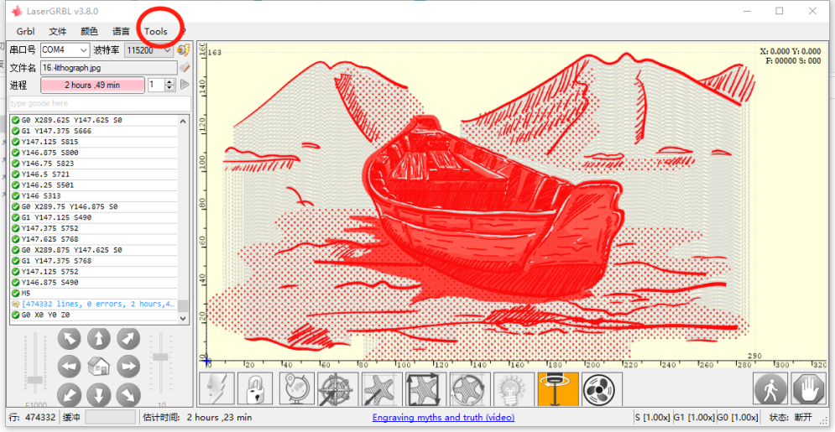
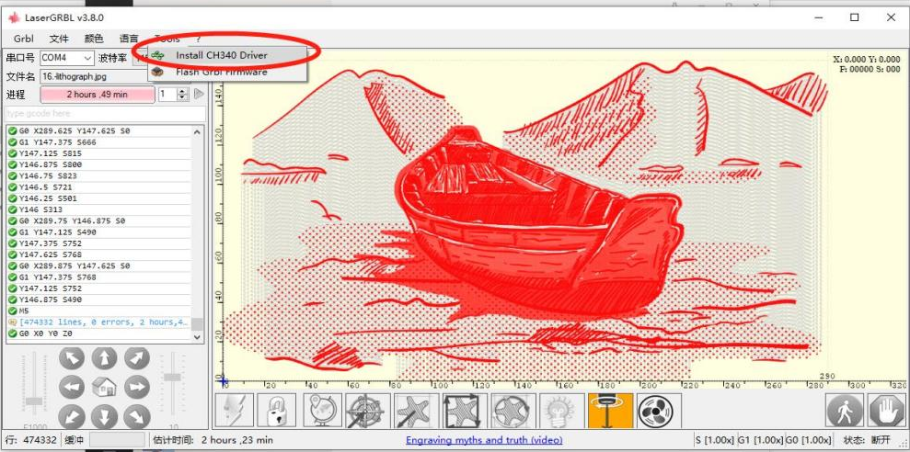
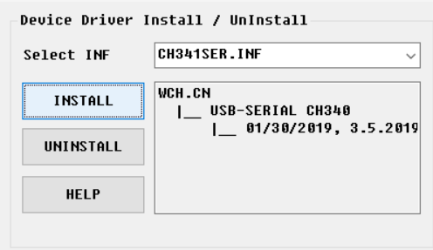
E.First, install CH340 Driver. In the LaserGRBL software, click "Tools">"install CH340 Driver" to install the driver, and restart the computer after installation to connect.
F.Click on the lightning connection logo in the software. When the lightning logo changes to a red X, the connection is success.
Connect the engraving machine
G. The computer and engraving machine chain machine failure, need to update the drive, the method is as follows
In LaserGRBL, click "Tools" > in turn. Install CH340 Driver "Update and install the Driver, restart the computer after the update, and then connect, as shown in the picture below.
Installation

Slide 19
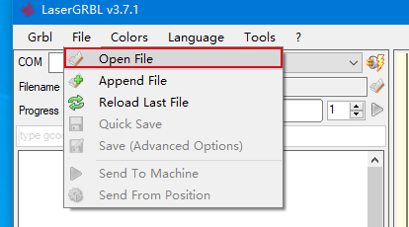
5. Setting engraving parameters
1. Select the engraving file.
Open LaserGRBL software, click "File"> "Open File", then select the graphics you want to engrave, LaserGRBL supports NC, BMP, JPG, PNG, DXF and other formats.
Open file
2.Picture parameters, engraving mode, engraving quality settings
a.LaserGRBL can adjust the sharpness, brightness, contrast, highlight and other attributes of the target picture, when adjusting the parameters of the picture, the factual effect will be shown in the right preview window, there is no standard here, just adjust the effect you want.
b. Engraving mode usually chooses "line to line tracking" and "1bit dithering", 1bit dithering is more suitable for engraving grayscale graphics. If you are going to cut, select the vector graphics or centerline engraving mode.
c. Engraving quality essentially refers to the line width of the laser scan, this parameter mainly depends on the size of the laser spot of the engraving machine, it is recommended to use an engraving quality of 8, The response to laser illumination varies from different materials, so the exact value depends on the specific engraving material.
d. at the bottom of the preview window, the image can also be rotated, mirror, cut, etc. operations.

Slide 20
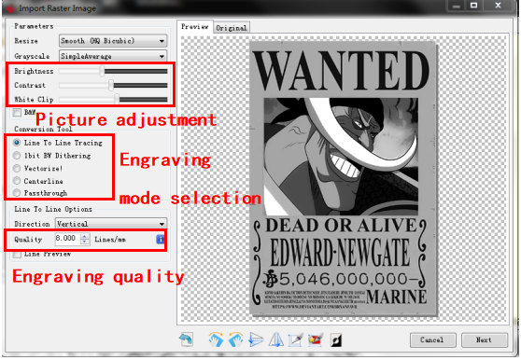
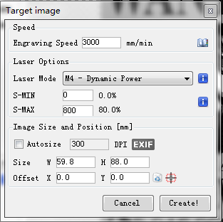
e. After completing the above settings, click next to the the settings of carving speed, carving energy and carving size.
Introduction of Setup Interface
3. Engraving speed, engraving energy and engraving size Setting
a. recommending the engraving speed for 3000, this is the best value for the engraving effect after repeated experiments, of course you can increase or decrease the speed according to your preference, faster speed will save the engraving time, but it may reduce the engraving effect, slower speed is the opposite.
b. In the selection of the laser mode, there are two commands for laser, M3 and M4, it is recommended to use the M4 command for 1bit litter engraving, and M3 command for other cases. If your laser only has M3 instruction, please check whether the laser mode is enabled in the GRBL configuration, please refer to the official instructions of LaserGRBL for GRBL configuration.
c. Choose the engraving energy according to different materials,
d. Finally, set the size you want to engrave, click on the "Create" button, all the engraving parameters have been set.
Speed recommendation 3000
Setting of engraving speed and laser power
Input appropriate energy according to your material
Enter the appropriate size according to the contour of the object to be carved

Slide 21
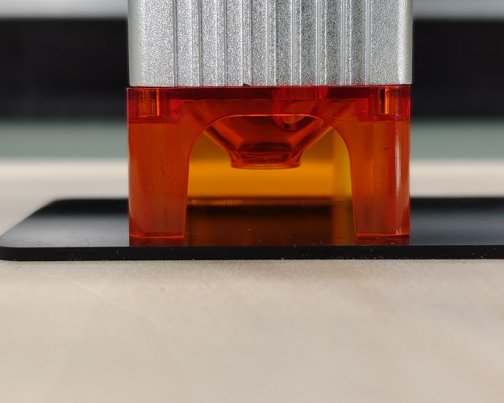
6. Laser focus adjustment
The effect of engraving or cutting largely depends on whether the laser is focused or not. Most of the existing laser engraving machines on the market use zoom lasers. It is necessary to turn the focus nut while staring at the laser spot to observe whether the laser is focused. Staring at the laser spot for a long time can hurt your eyes (even with goggles), and it is difficult to distinguish small changes in focus, so it is difficult to find the best laser focus.
In order to solve this problem, we abandoned the traditional zoom laser and installed a fixed-focus laser on our engraving machine. The focus is on the thickness of a fixed-focus film of the laser, and the fixed-focus film is attached to the package. When using, only need to adjust the laser.
The following is the specific operation:
A. Move the laser head to the object to be engraved or cut.
B. Place a fixed focus film on the object to be engraved or cut.The focal distance of different power lasers is 5W 2mm,10W 3mm and 20W 4mm
Placing fixed-focus piece
Fixed-focus film thickness
Laser focus

Slide 22
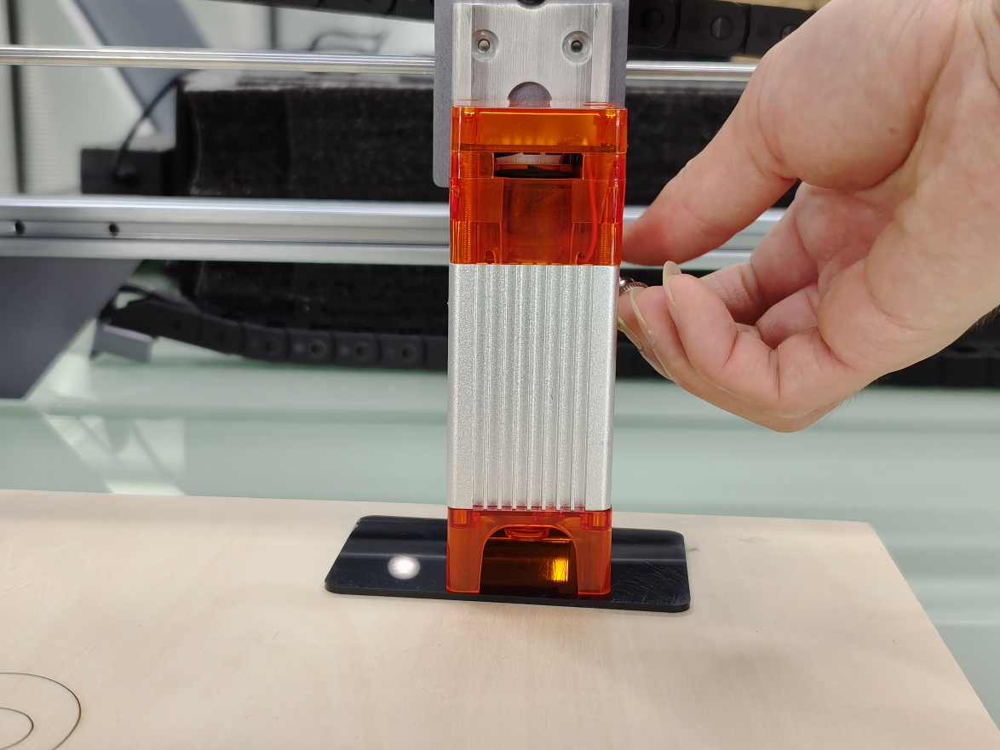
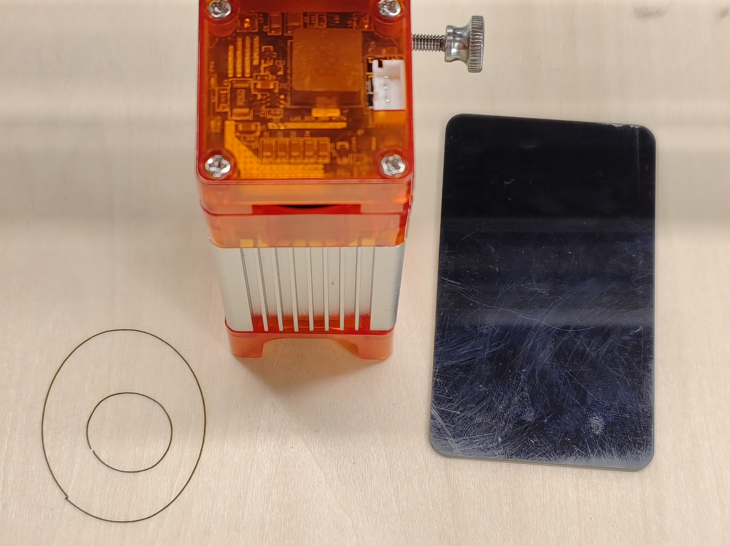
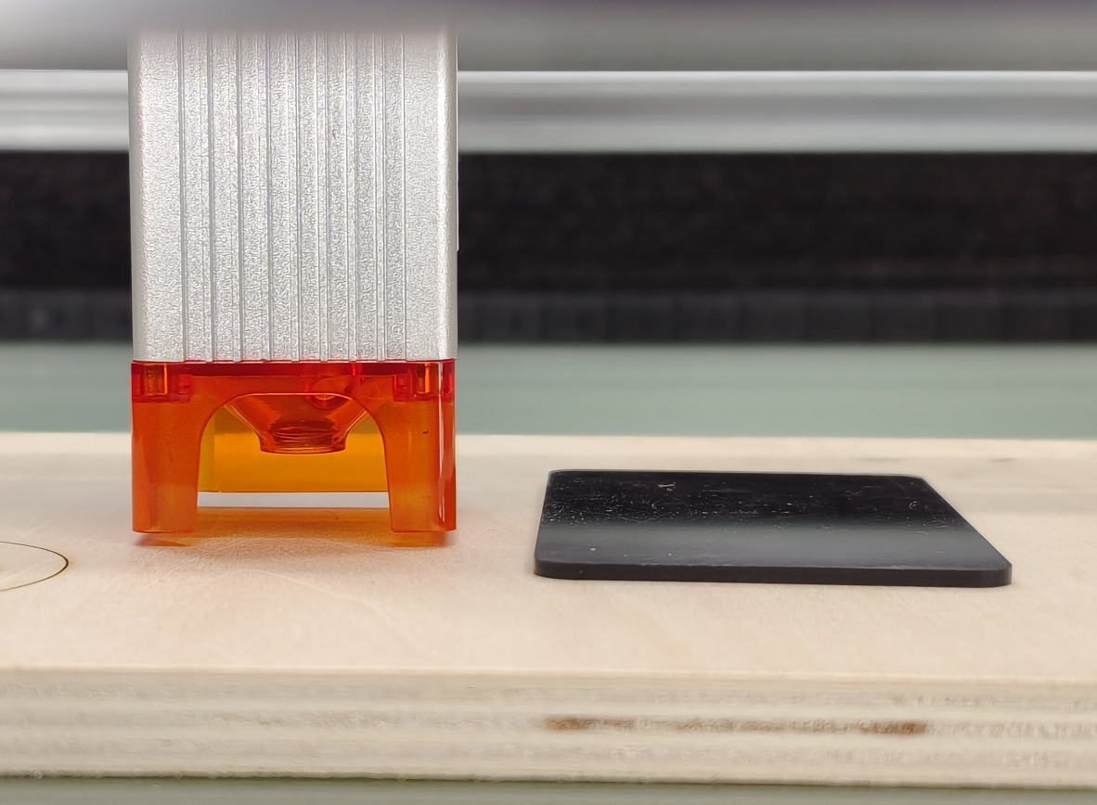
C. Secure the laser with two screws to the right of the machine's slider and allow the laser to slide freely until it touches the prime focus
Adjusting the laser distance
D. Tighten the two screws securing the laser to the right side of the slider
E.Take out the fixed focus piece and finish focusing.
Take out the fixed focus piece
Fixed-focus film thickness

Slide 23

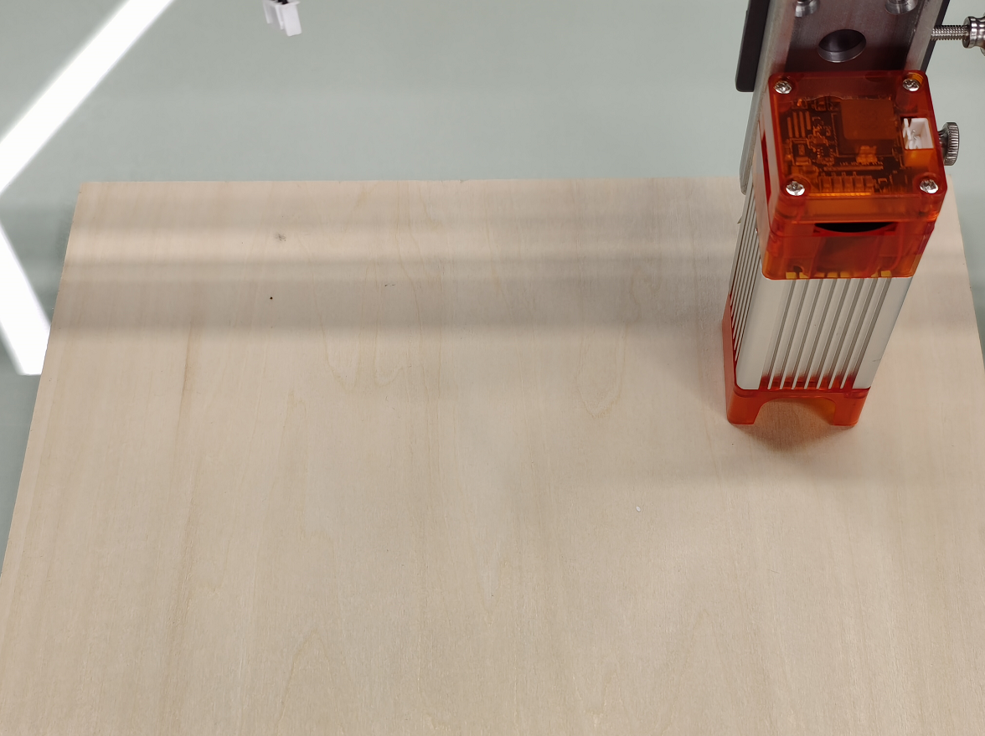
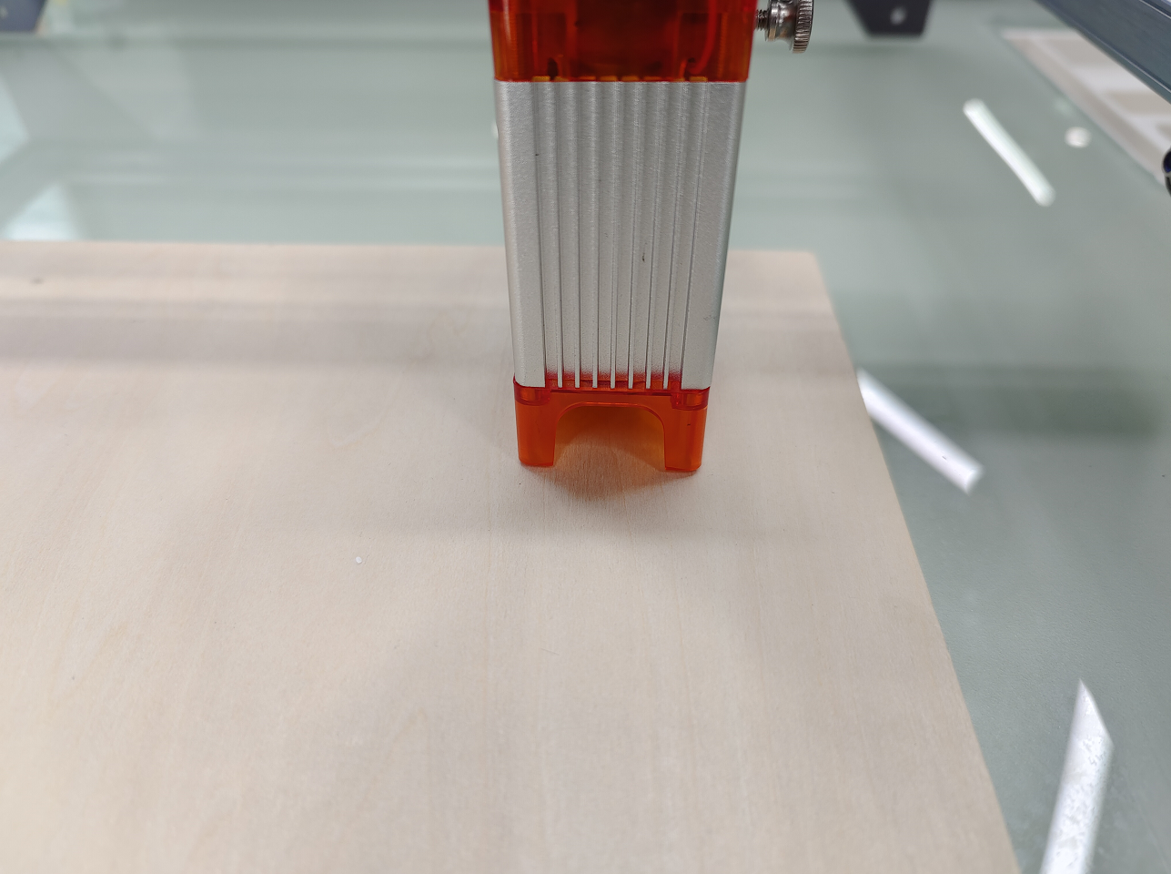
7. Positioning
A. The engraver does not know where to engrave, so before you start engraving, there is an important task which is positioning. We will complete the positioning operation in three steps.
B. Select the "Move to Center" button, the laser will move to the center of the pattern, and the engraving will be placed below the laser.
1
2
Step1： Move to Center
Step2： light laser
C. Click "light laser" button, the laser will emit a weak light, the laser emits irradiation point is the center of the engraving pattern, based on this, adjust the position of the engraved object!

Slide 24
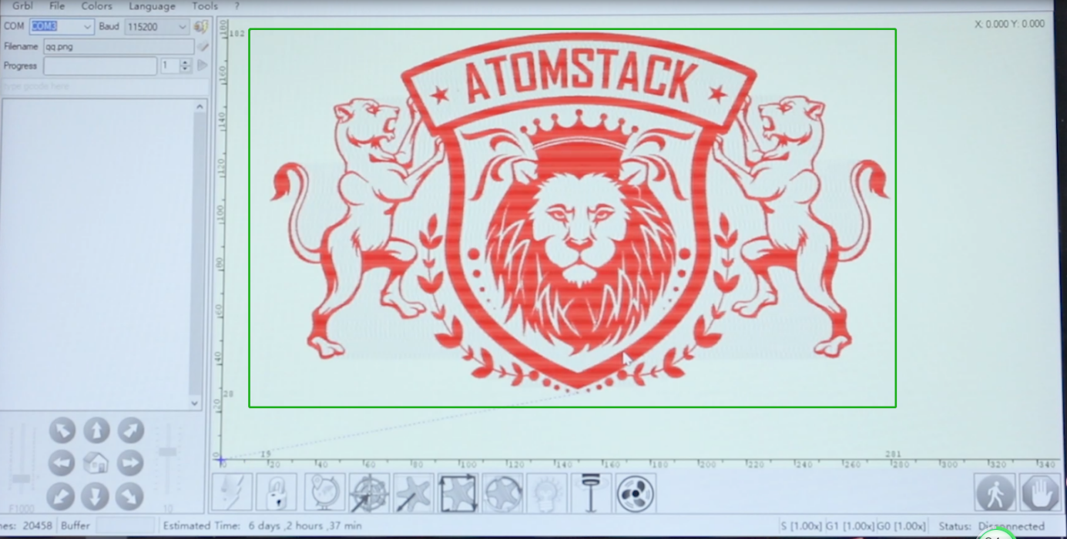
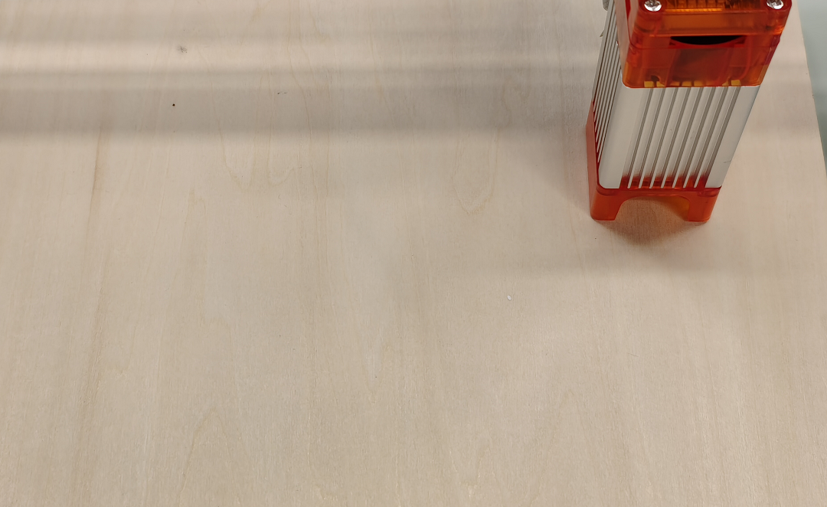
D. Click "Profile Scan" button, the laser will start to scan the outer contour of the pattern on the computer, you can change the position of the engraved object again according to the scanned outer contour position. Besides, You can click on the "wrap-around" button for several times until the outer contour is at the position you want to engrave.
3
Step3： Profile Scan

Slide 25
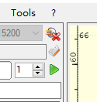

8. Start, Termination carving or cutting
1. Start:
After finishing all the above operations, click the green button as shown in the figure to start engraving. There is a number that can be edited next to the start button. It is the number of times of engraving or cutting, LaserGRBL allows multiple consecutive engraving or cutting of uniform shapes, this function is especially useful for cutting.
Picture 1 Start
2. Termination
If you want to terminate the job midway, you can click the terminate button as shown in the picture to terminate the engraving or cutting.
Picture 2 Stop

Slide 26

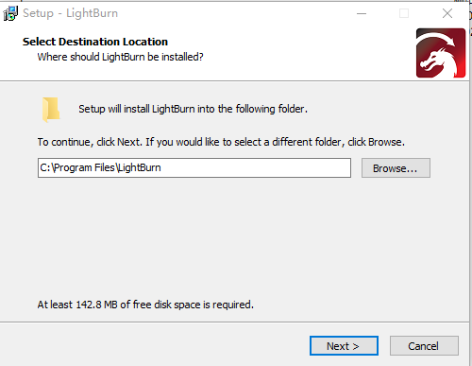
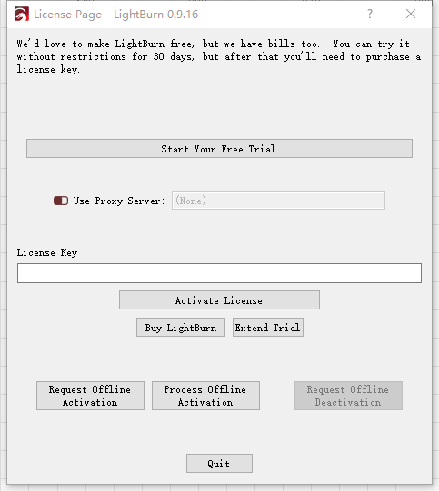

9. LightBurn Installation Tutorial
We can download the installation package from the LightBurn website:
We can download the installation package from the LightBurn website:
https://lightburnsoftware.com/
Picture3：LightBurn Software package
Double-click on the installation package to install and click "Next" in the pop-up window.
(Note: LightBurn is a paid software, for better experience we recommend you buy the original one, here we will demonstrate the installation of the trial version)
Picture 4：
Select the
installation path
Click Start Your Free Trial（Picture 5）
Click Find My Laser （Picture 6）
Picture 6：Click”Find my laser”
Picture 5：Choose a free trial

Slide 27



Click Find My Laser （Picture 7）
Picture 7：Click GRBL,then Click add Device
To set the origin, we usually set the origin in the front left.
Picture 8：set the origin in the Front left.
If the computer cannot be connected to the machine, we can try to select different ports of the laser engraving machine, as shown in the image below. If it still doesn't work, please contact our customer service

Slide 28



Part 7: Techniques for using machines
1. The closer the laser is to the table, the less stable the structure will be, try to elevate the laser as far away from the table as possible when using the laser.
2. Precise positioning of the pattern and the engraved object.
a.Move the laser to the lower left of the frame.
b. Using a ruler and pencil to draw a center point on the engraved object（Picture 1）.
c.The shield must be parallel to the edge of the engraved object（Picture 2）.
Picture 1 draw a center point on the engraved object
Picture 2 The shield is parallel to the edge of the engraved object
d.Click on the following two buttons in sequence to move the laser so that the laser point moves to the center of the engraving. Once the positioning is complete, you can start engraving.
1
2
Picture 3 center point positioning

Slide 29
Part 8: Maintenance instructions and warning
This product uses a highly integrated design and requires no maintenance. However, if the laser system installed with this product needs to be repaired or adjusted, please:
Unplug the power connecter on the laser, so that the laser is in a state of power failure;
If you need laser assistance for adjustment, please:
  All present personnel wear protective glasses,OD5+ protective glass is needed ;
  Make sure there are no flammable or explosive materials around;
  The position and direction of the laser are fixed to ensure that the laser will not accidentally move and shine on people, animals, flammable, explosive and other dangerous and valuable objects during debugging.
  Don't look at lasers
  Do not shine the laser on the mirror object, lest the laser reflection cause accidental injury.
3. Laser module cleaning
After a period of utilization for the laser module, there will be some remains staying at the protective cover, heat sink, and the laser head. The remains need to be cleaned in time so that not affect the use of the laser module.The windshield and protective cover must be removed before cleaning.

Slide 30
Part 9:List of accessories
1. Instruction manual *1
2.Eye protection glasses *1
3.USB communication cable *1
4.Clean the brush *1
5.Try small wooden boards *3
6.Try small acrylic plates *3
7.Determine the focus block *1
8.Open end wrench *1
9.Screw-bag *7 （M5×25mm*4PCS、M5×8mm*4PCS、M5×15mm*7PCS、
M5×6mm*4PCS、 M3×6mm*8PCS、 M4×12mm*2PCS、)
10.Dust-free cloth *1
11.Cable ties *10
12.H3 hexagonal L-shaped wrench*1
13.H2 hexagonal L-shaped wrench*1
14.H2.5hexagonal L-shaped wrench*1
15.Air-assisted pumps *1 (A710W and G3 models only)
16.Rotary Roller User Manual *1(Only available on A710W+Roller and G3+Roller models)

Slide 31

Part 10: Precautions for common problems
1.Please select the correct COM port for connecting the software and equipment, and the baud rate should be selected: 115200, to ensure that the connection between the computer port and the USB cable is not loose.If you need laser assistance for tuning, please:
2.Before engraving, please confirm whether each mechanism is loose (synchronous belt, eccentric column of roller, and laser head are loose or shaken)
3.Correctly adjust the focus and confirm that the distance from the end of the laser protective cover to the engraving is Fixed-focus film thickness.
4.LaserGRBL/LightBurn software can refer to the parameter table in the corresponding manual for engraving and cutting different materials. The engraving of mirror metal requires manual surface blackening treatment.
Address：Baoshanqu Shuangchenglu 803long 11hao 1602A-1609shi Shanghai
Imported to USA: Sanven Technology Ltd., Suite 250, 9166 Anaheim Place, Rancho Cucamonga, CA 91730
MADE IN CHINA

Slide 32

Technical Support and E-Warranty Certificate
www.vevor.com/support

